Slide 1
Chapter 14 Glycolysis, the pentose phosphate pathway and the catabolism of glycogen

Slide 2
Glycolysis (糖酵解)
The process in which a molecule of glucose is degraded in a series of enzyme-catalyzed reactions to yield two molecules of pyruvate.

Slide 3
Overview on glucose metabolism
The major fuel of most organisms and occupies a central position in metabolism (ΔG'º= -2840 kJ/mol when completely oxidized).
Can be stored in polymer form (glycogen or starch) or be converted to fat for long term storage.
Can also be oxidized to make NADPH and ribose 5-phosphate via the pentose phosphate pathway.
Is also a versatile precursor for carbon skeletons of almost all kinds of biomolecules.

Slide 4
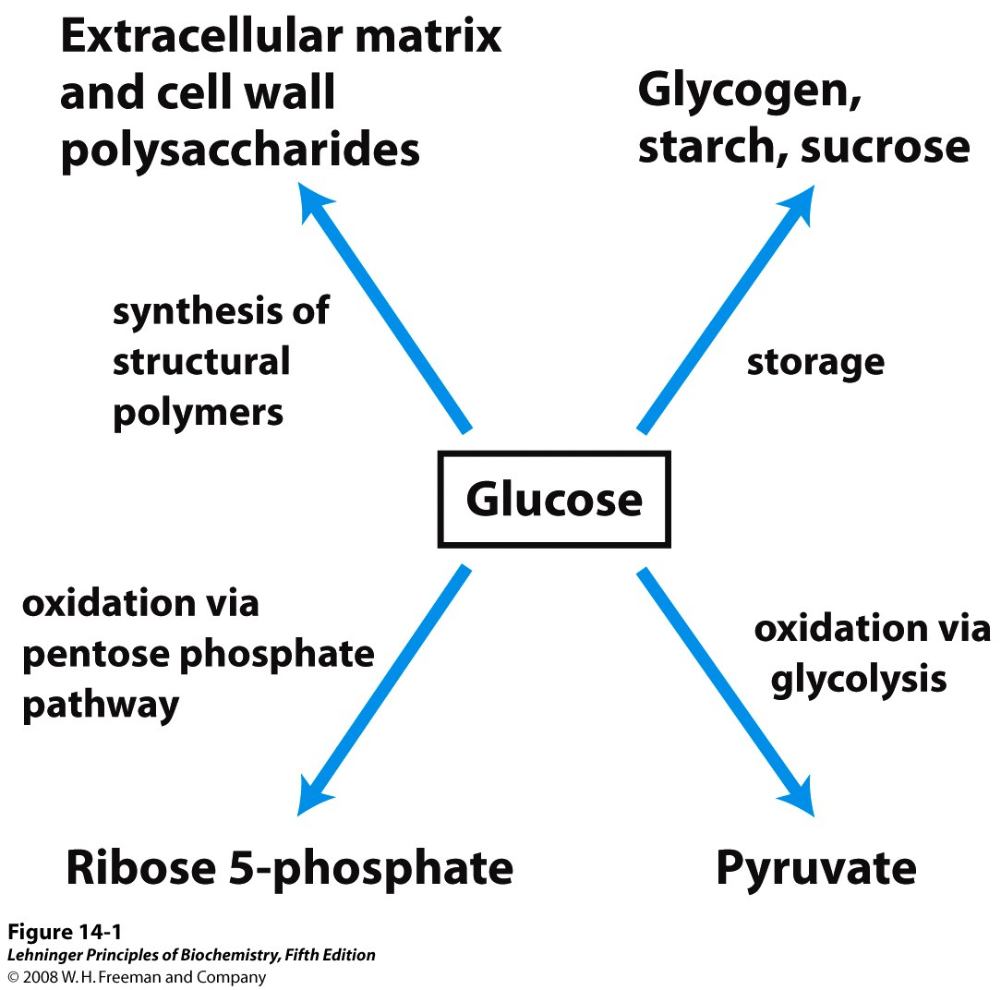
Major pathways of glucose utilization

Slide 5
Glycolysis
The first stage in the complete oxidation of glucose
An universal central pathway of glucose metabolism
The chemistry of the reaction sequence completely conserved during evolution
The first metabolic pathway to be elucidated and probably the best understood

Slide 6
1. The development of Biochemistry and the delineation of glycolysis went hand by hand
In 1897, accidental observation by Eduard Buchner: sucrose (as a preservative) was rapidly fermented into alcohol by cell-free yeast extract.
The accepted view that fermentation is inextricably tied to living cells (i.e., the vitalistic dogma) was shaken and Biochemistry was born: Metabolism became chemistry!

Slide 7
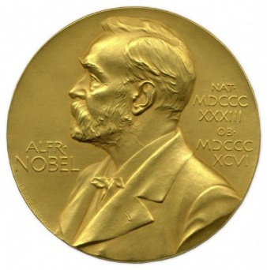
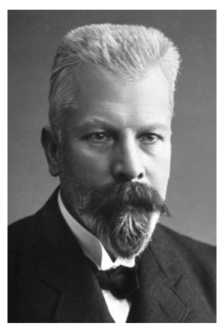

The Nobel Prize in Chemistry 1907
“for his biochemical researches and his discovery of cell-free fermentation”
Eduard Buchner
Germany
Landwirtschaftliche Hochschule (Agricultural College)
Berlin, Germany
1860-1917

Slide 8
In 1900s, Arthur Harden and William Young (Great Britain) found that P_{i} is needed for yeast juice to ferment glucose, a hexose diphosphate (fructose 1,6-bisphosphate) was isolated.
They also separated the yeast juice into two fractions: one heat-labile, nondialyzable zymase (enzymes) and the other heat-stable, dialyzable cozymase (metal ions, ATP, ADP, NAD⁺).

Slide 9
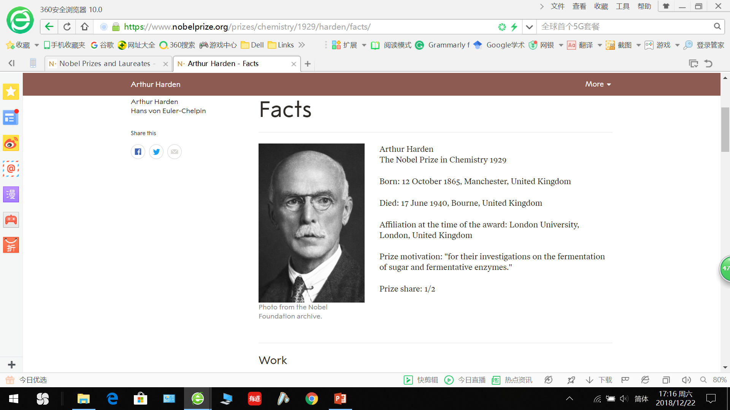
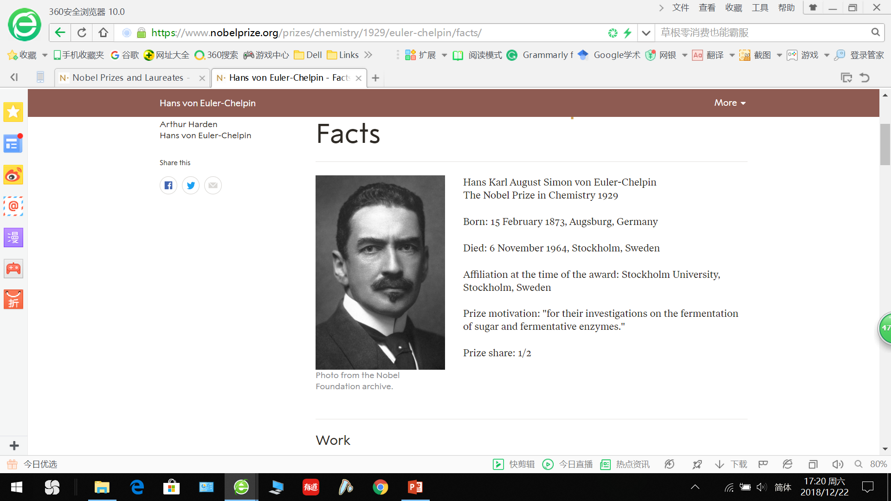
The Nobel Prize in Chemistry 1929
“for their investigations on the fermentation of sugar and fermentative enzymes”
Sir Arthur Harden
Great Britain
London University, London, Great Britain
1865 -1940
Hans von Euler-Chelpin
Sweden
Stockholm University, Stockholm, Sweden
1873-1964

Slide 10
1910s-1930s, Gustav Embden and Otto Meyerhof (Germany), studied muscle and its extracts:
Reconstructed all the transformation steps from glycogen to lactic acid in vitro; revealed that many reactions of lactic acid (muscle) and alcohol (yeast) fermentations were the same!
Discovered that lactic acid is reconverted to carbohydrate in the presence of O₂ (gluconeogenesis); observed that some phosphorylated compounds are energy-rich.
The whole pathway of glycolysis (from glucose to pyruvate) was elucidated by the 1940s.

Slide 11

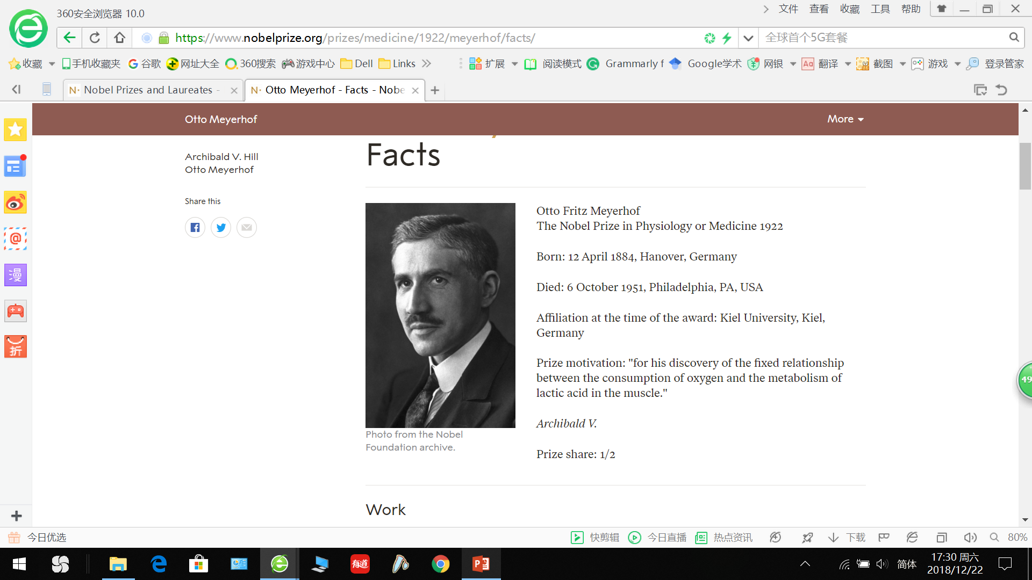

The Nobel Prize in Physiology or Medicine 1922
“for his discovery relating to the production of heat in the muscle”
“for his discovery of the fixed relationship between the consumption of oxygen and the metabolism of lactic acid in the muscle”
Sir Archibald Vivian Hill
Great Britain
London University, London, Great Britain
1886-1977
Otto Fritz Meyerhof
Germany
Kiel University, Kiel, Germany
1884 -1951

Slide 12
Basic facts about glycolysis
Ten steps of reactions are involved in the pathway.
Six types of reactions occur: group transfer, isomerization, aldol cleavage, dehydrogenation, group shift, and dehydration.
All the enzymes are found in the cytosol.
All intermediates are phosphorylated.
Only a small fraction (~5.2%) of the potential energy of the glucose molecule is released and much still remains in the final product of glycolysis, pyruvate.

Slide 13
2. The overall glycolytic pathway can be divided into two phases
Preparatory phase: Glucose is converted into glyceraldehyde 3-phosphate, consuming ATP.
Payoff phase: Glyceraldehyde 3-phosphate is oxidized to generate pyruvate, generating ATP and NADH.

Slide 14
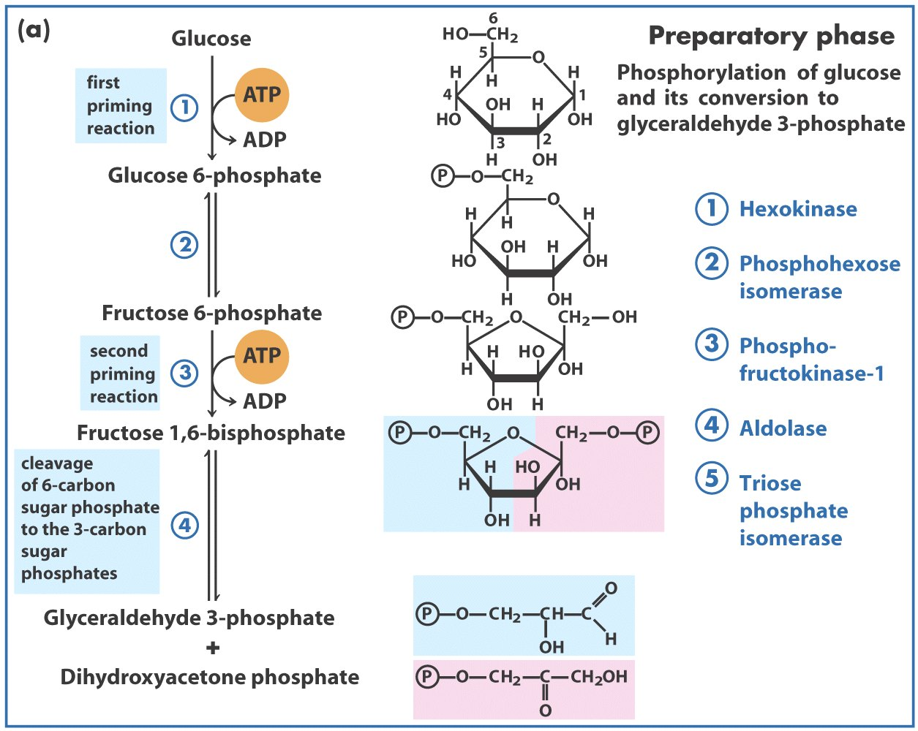
Group
transfer
Isomerization
Group
transfer
Aldol cleavage
Isomerization

Slide 15
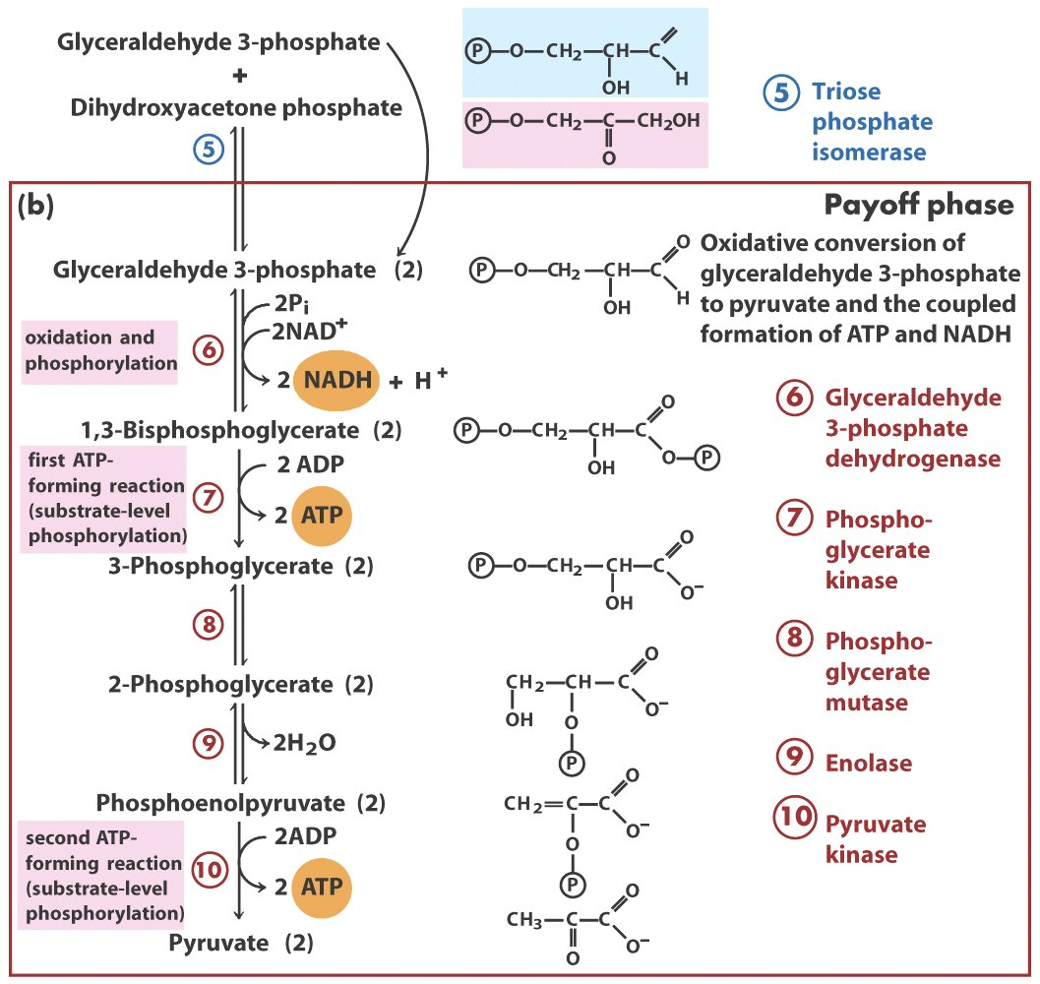
Isomerization
Dehydrogenation
Group transfer
Group shift
Dehydration
Group transfer

Slide 16
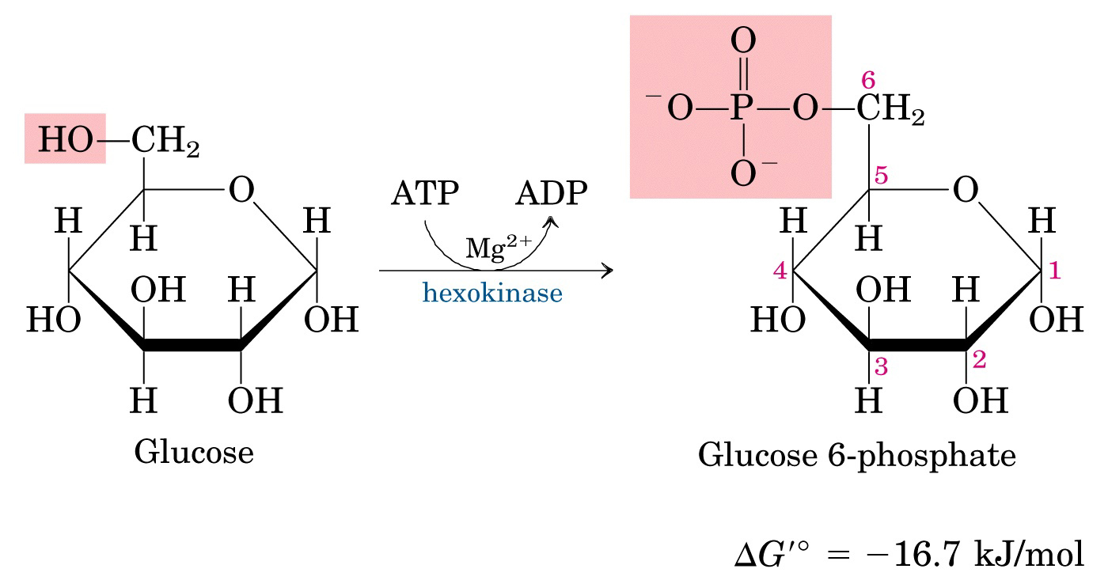
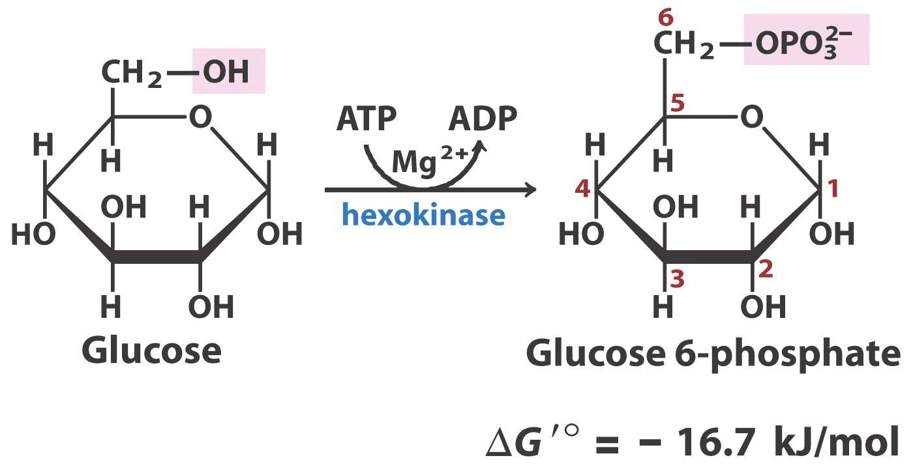
Step 1
Preparatory Phase
Irreversible
exergonic
Irreversible in cells
MgATP²⁻, not ATP⁴⁻, is the actual substrate

Slide 17
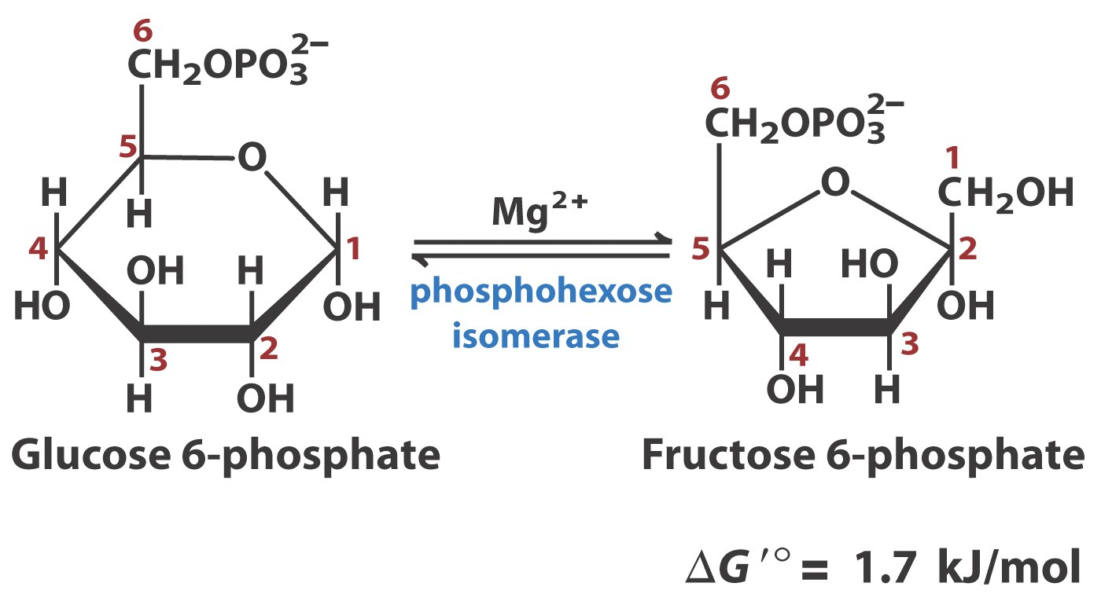
Step 2
Preparatory Phase
Aldose
Ketose
Reversible
Reversible

Slide 18
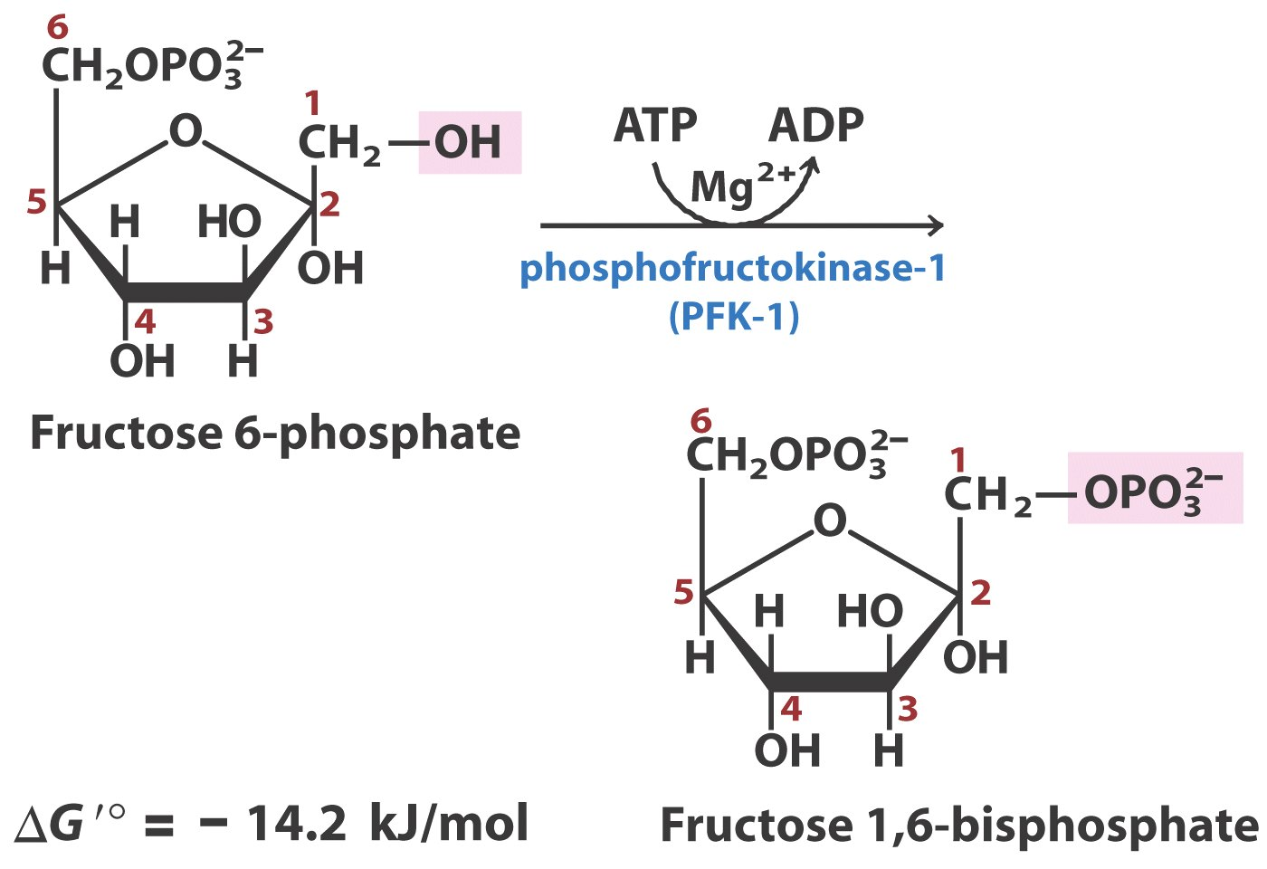
Step 3 The commitment step
Preparatory Phase
(PFK1)
Irreversible
exergonic

Slide 19
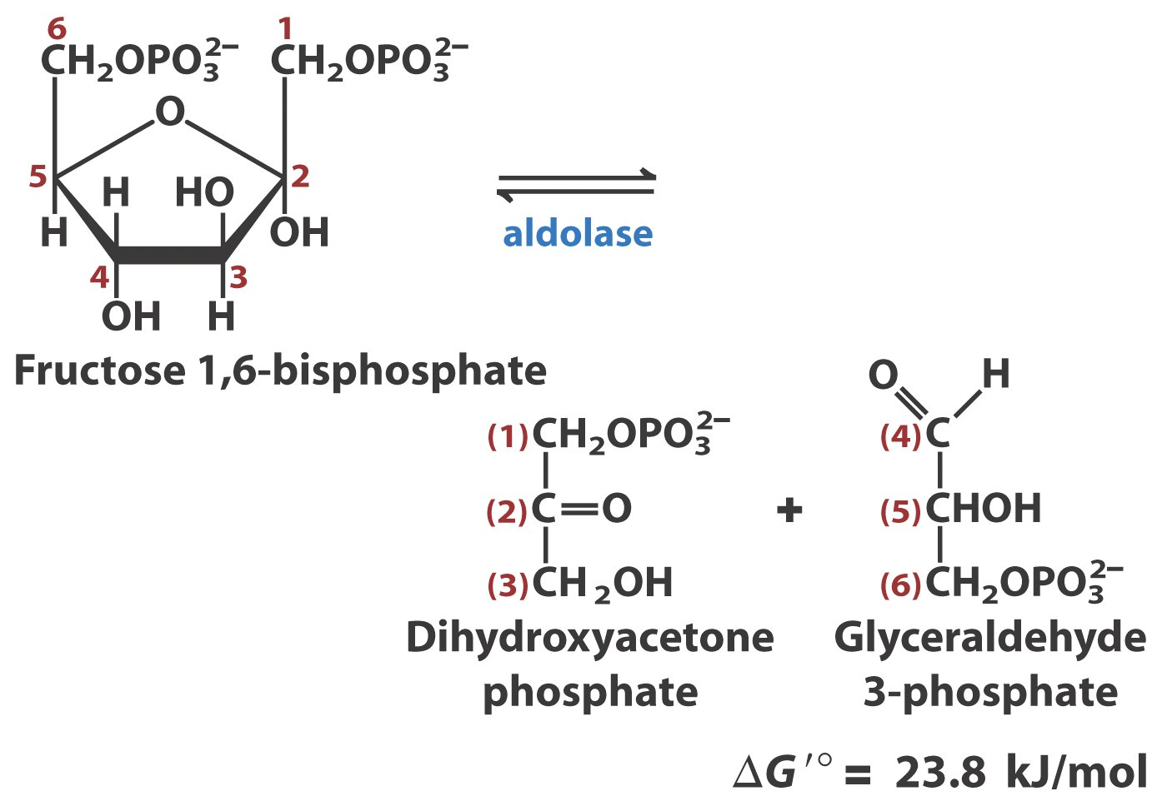
Preparatory Phase
Step 4 The “lysis” step
Ketose
Aldose

Slide 20
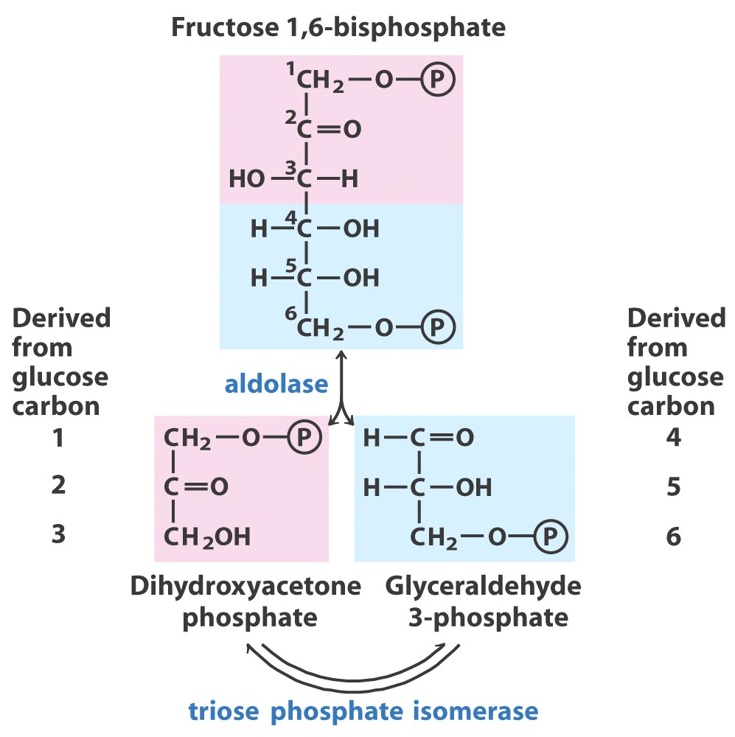

Slide 21
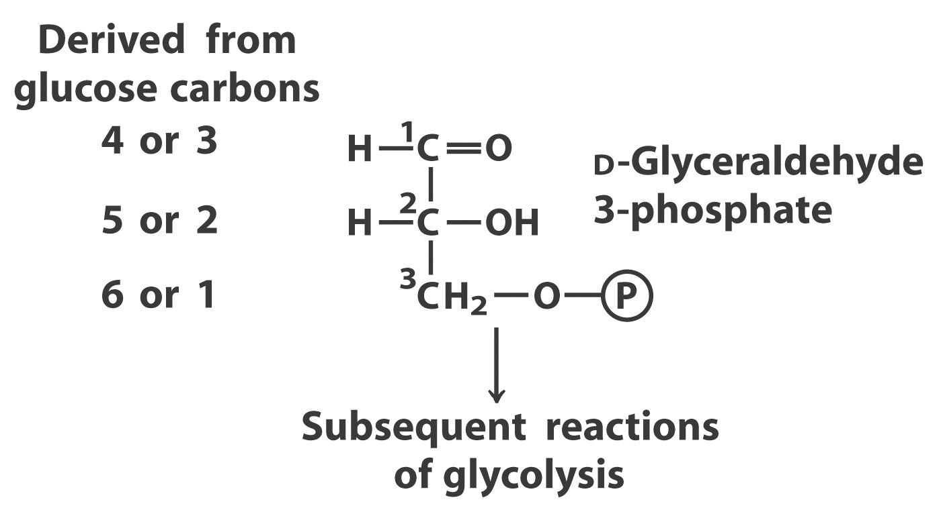

Slide 22
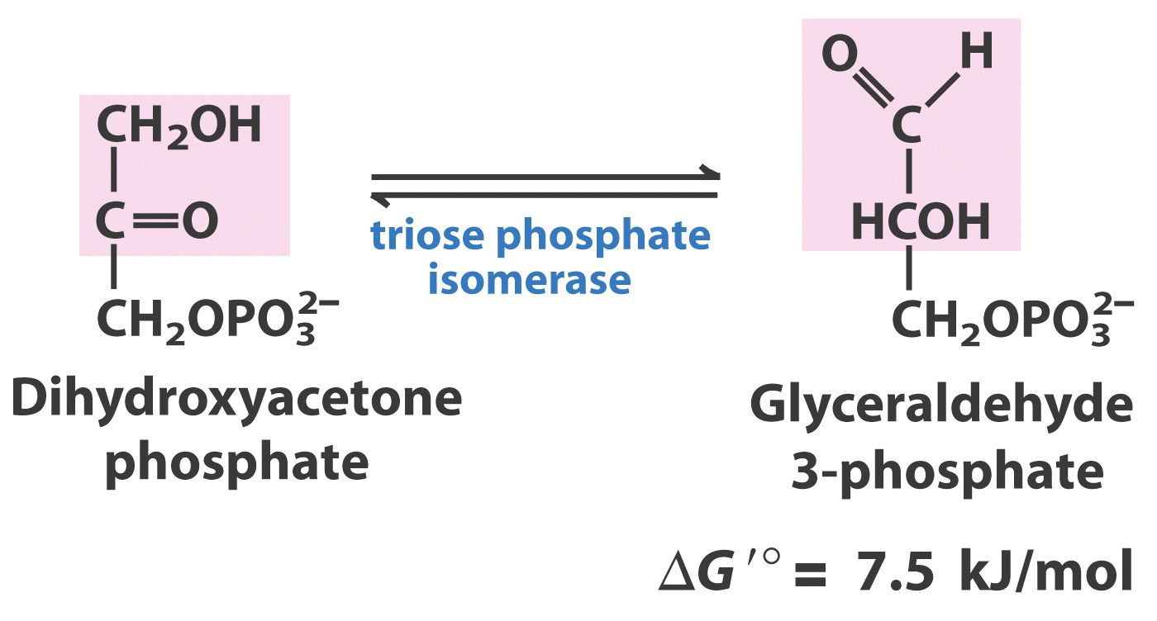
Step 5
Preparatory Phase
Reversible
Ketose
Ketose
Aldose

Slide 23
Group
transfer
Isomerization
Group
transfer
Aldol cleavage
Two molecules
of ATP are
consumed
Isomerization

Slide 24
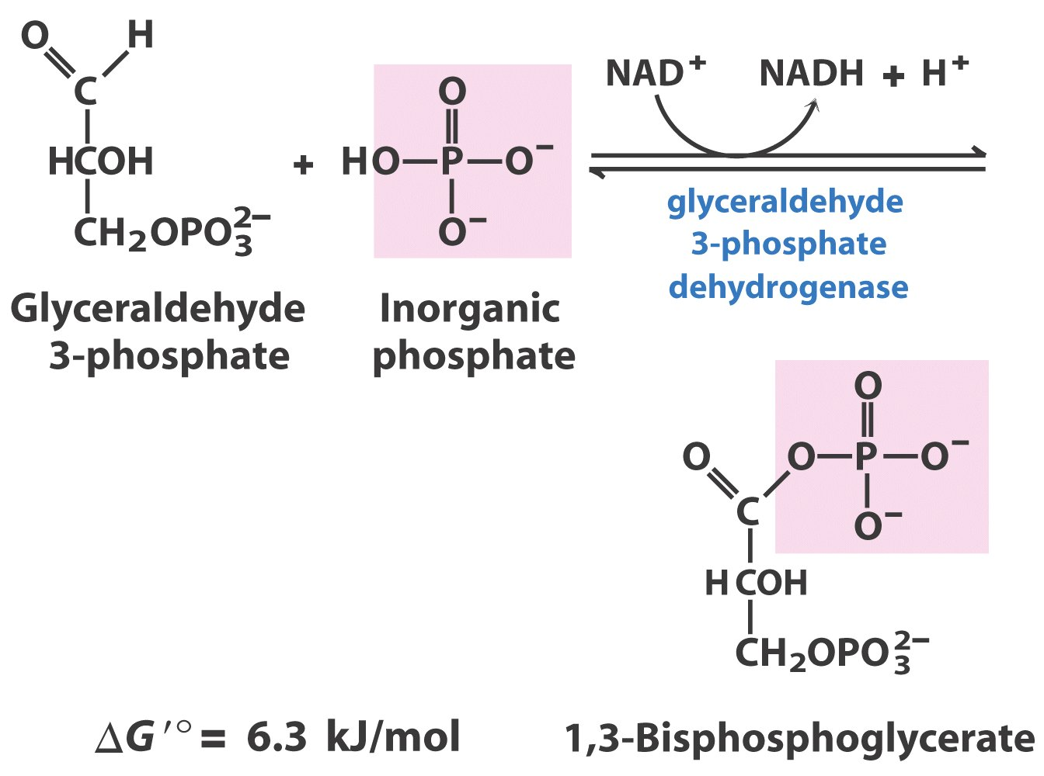
Payoff Phase
Step 6 Oxidation and phosphorylation reaction
Acyl phosphate

Slide 25
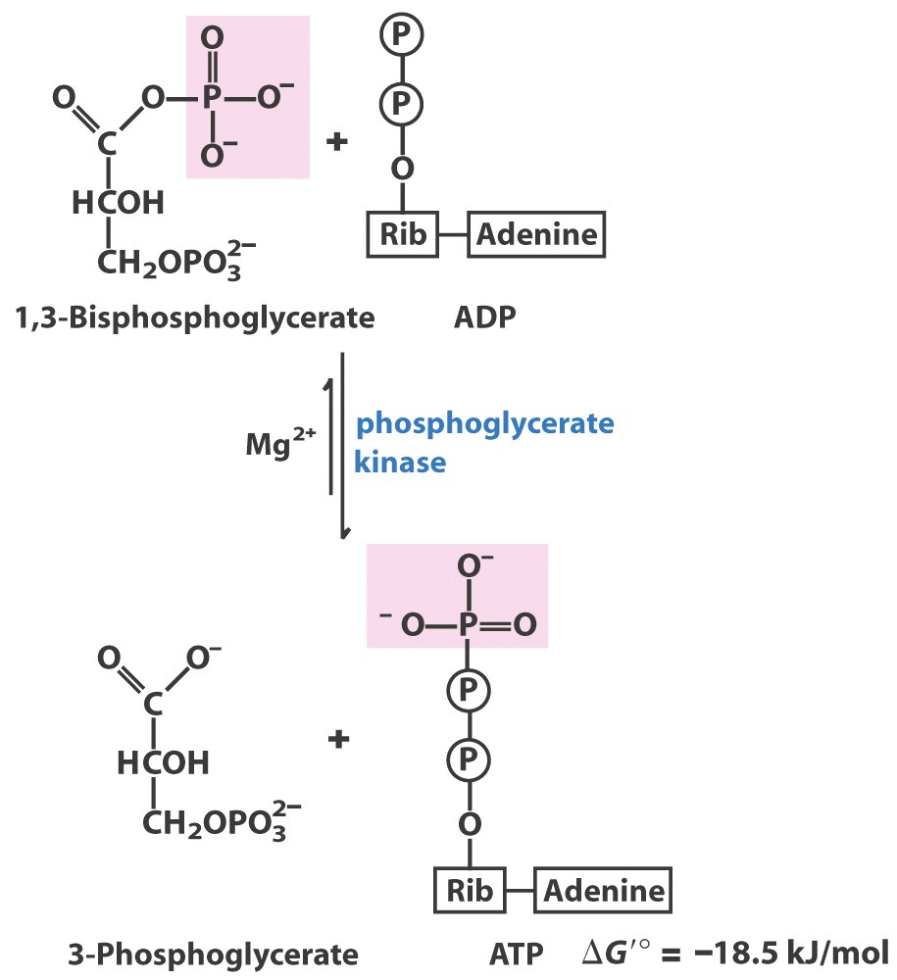
Payoff Phase
Step 7
Substrate-level
phosphorylation
for ATP generation

Slide 26
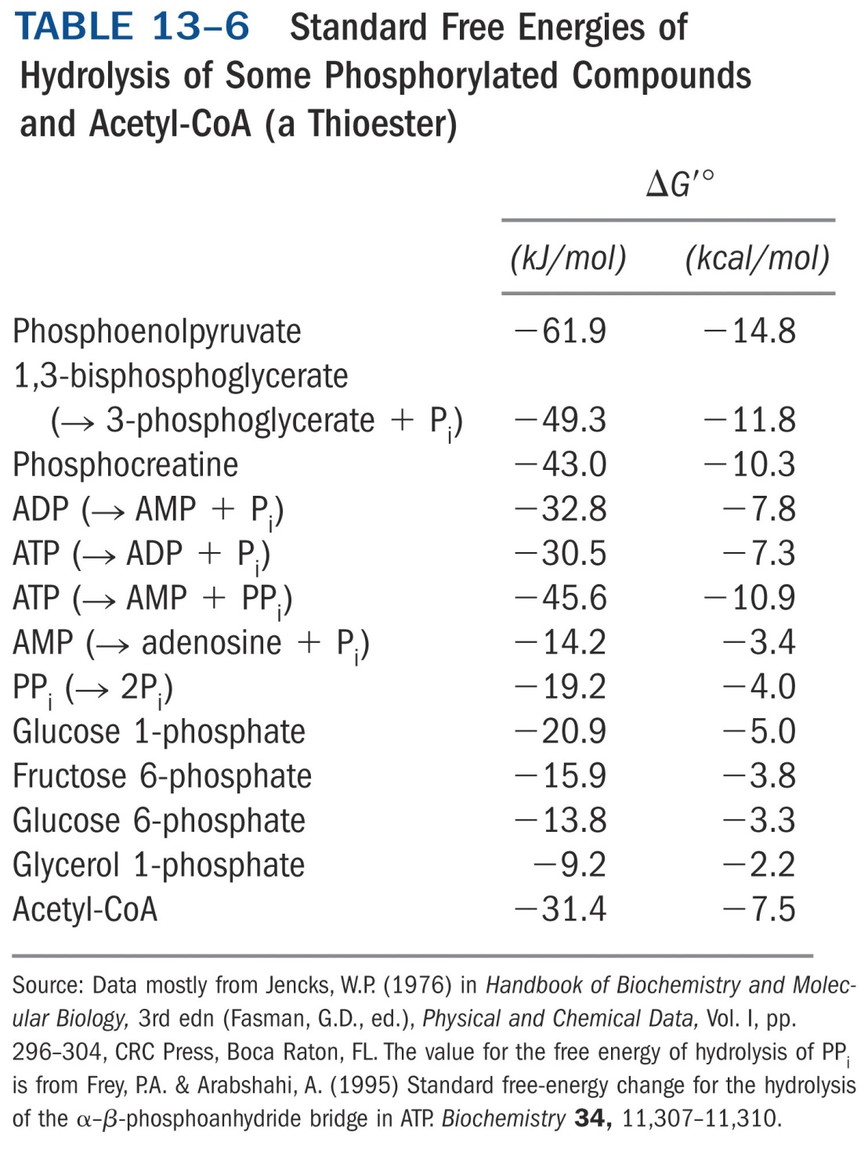

Slide 27
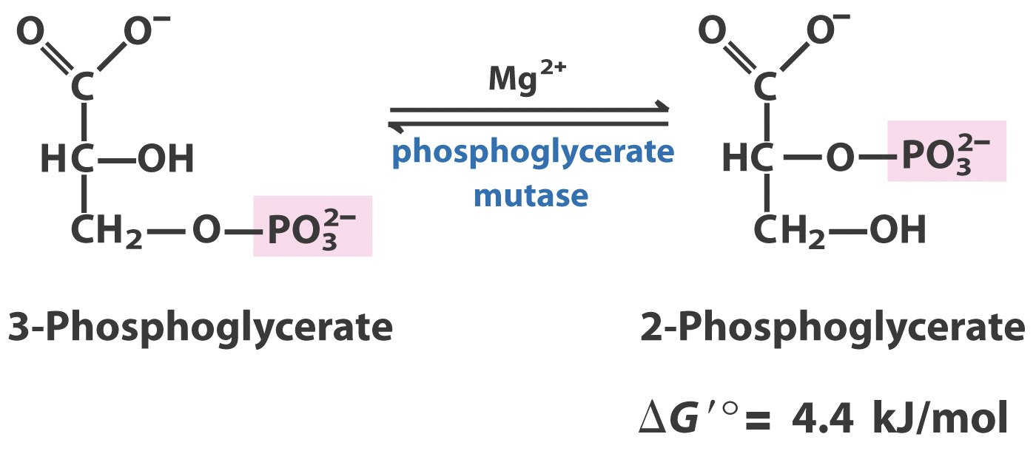
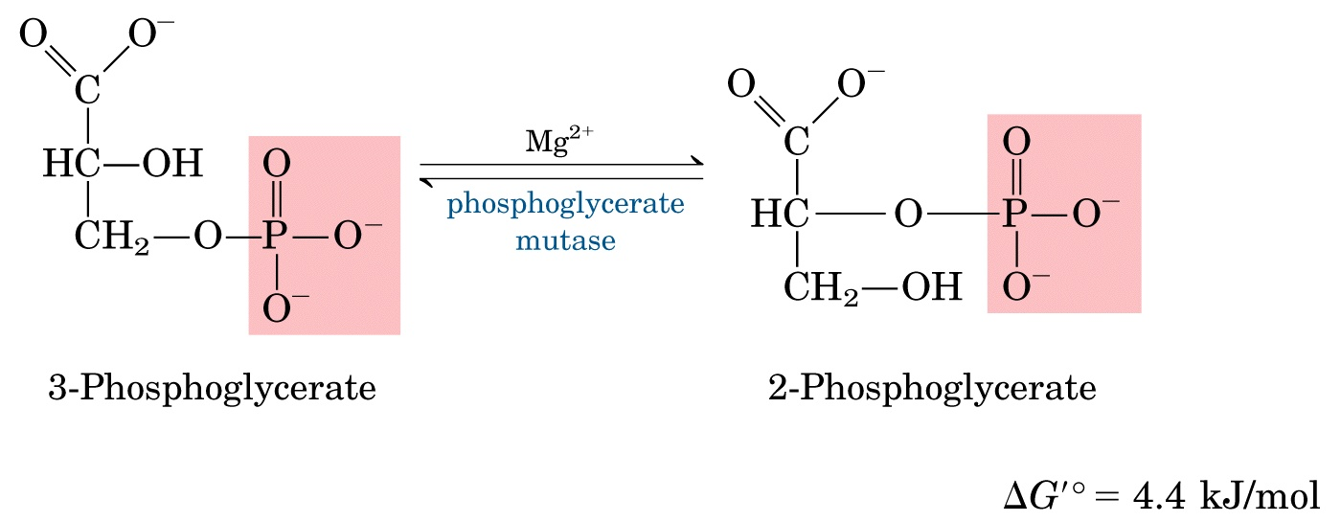
Step 8
Payoff Phase
2,3-bisphosphoglycerate is both a coenzyme
and an intermediate of the reaction

Slide 28
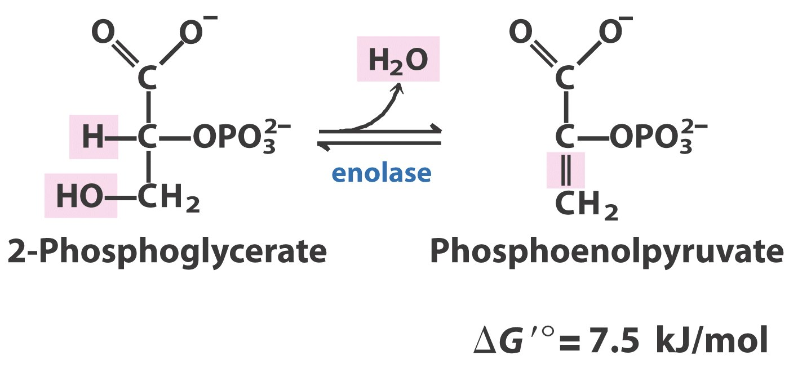
Step 9
Payoff Phase
Reversible

Slide 29
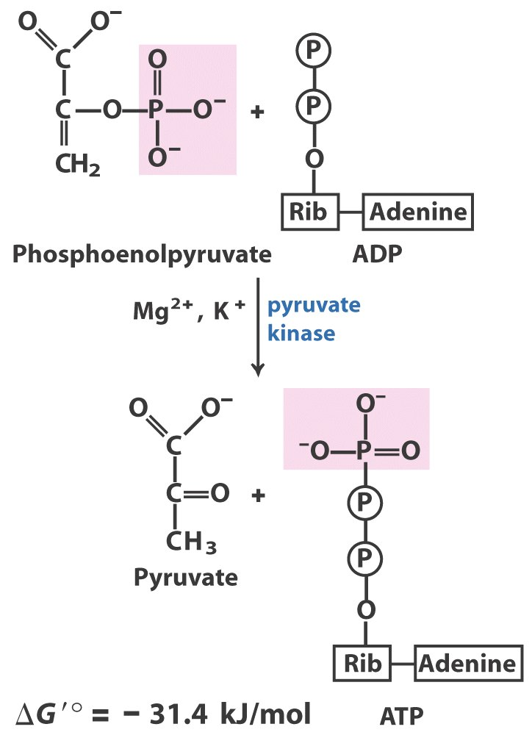
Step 10
Payoff Phase
Substrate-level
phosphorylation
for ATP generation
Irreversible
exergonic

Slide 31
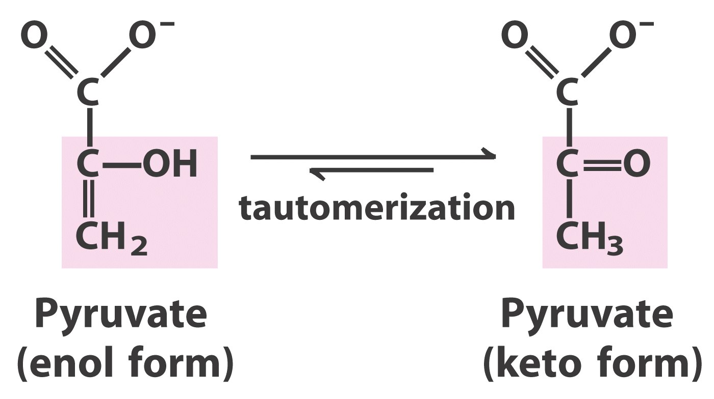
Spontaneous

Slide 32
Isomerization
Dehydrogenation
Group transfer
Group shift
Dehydration
Group transfer
Four molecules of ATP and
two molecules of NADH
are generated

Slide 33
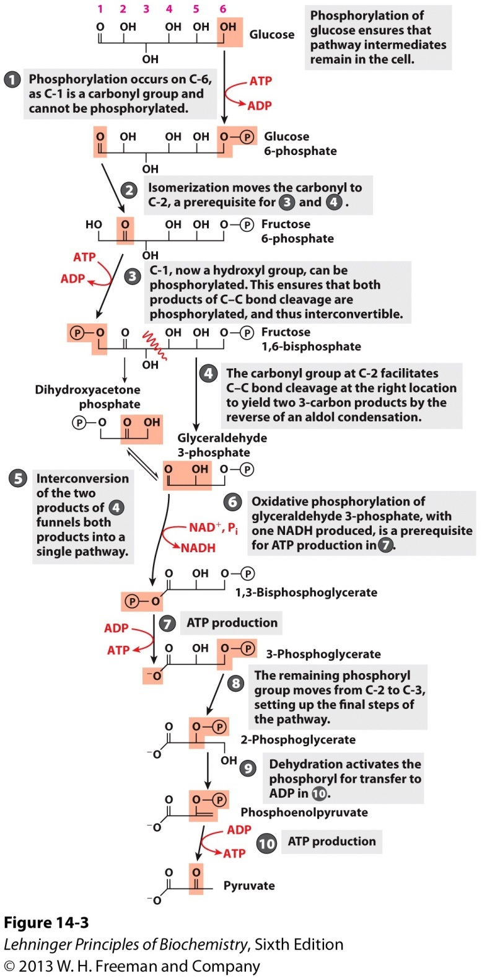
The chemical logic of
the glycolytic pathway

Slide 34
A net gain of two ATP, two NADH, two molecules of pyruvate are resulted when a glucose molecule is oxidized via the glycolysis pathway:
Glucose + 2 ADP + 2P_{i} + 2NAD⁺→
2 pyruvate + 2ATP + 2H₂O +
2NADH + 2H⁺
ΔG'º = -85 kJ/mol

Slide 35
Glucose
ATP
hexokinase
Glucose 6-phosphate
ADP
phosphohexose isomerase
Fructose 6-phosphate
ATP
phosphofructokinase-1
Fructose 1,6-bisphosphate
ADP
aldolase
Dihydroxyacetone phosphate
+ Glyceraldehyde 3-phosphate
triose phosphate isomerase
Glyceraldehyde 3-phosphate (2)
2Pi
glyceraldehyde 3-phosphate dehydrogenase
2NAD⁺
2NADH
+ H⁺
1,3-Bisphosphoglycerate (2)
phosphoglycerate kinase
2ADP
3-Phosphoglycerate (2)
2ATP
phosphoglycerate mutase
2-Phosphoglycerate (2)
enolase
Phosphoenolpyruvate (2)
2ADP
pyruvate kinase
Pyruvate (2)
2ATP

Slide 36
Importance of phosphorylated intermediates
Negatively charged, can’t diffuse out of the cell, therefore, no energy is needed to retain them in the cell
Energy conserved in the phosphorylated compounds
Lower the activation energy and increase specificity of the enzymatic reactions (the substrate binding sites of many glycolytic enzymes are specific for complexes of Mg²⁺ and the phosphate group of glycolytic intermediates)

Slide 37
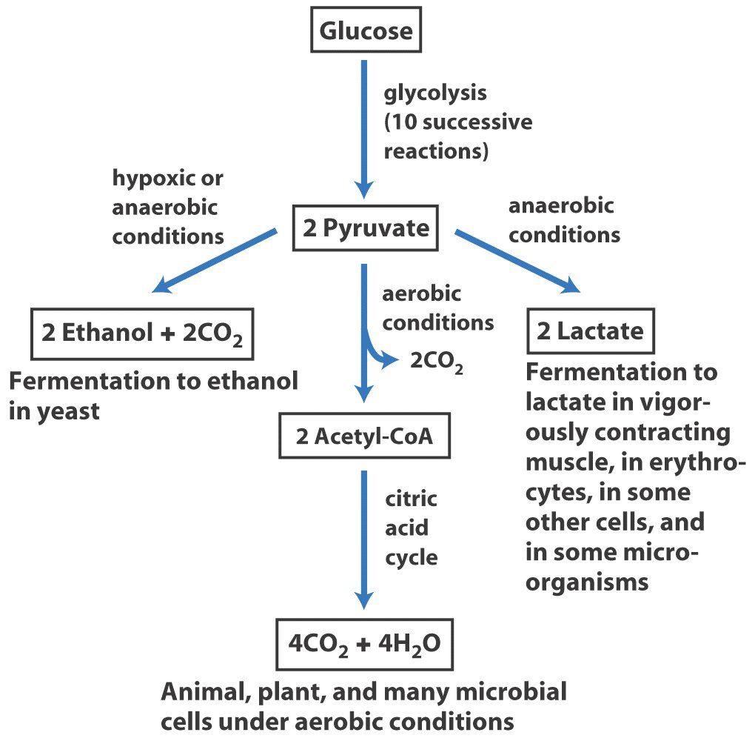
Fates of pyruvate
Serve as a precursor
in anabolic reactions

Slide 38
3. Fermentation: pyruvate is converted to lactic acid or ethanol under anaerobic conditions
This occurs to regenerate NAD⁺ for the glycolysis pathway to continue when O₂ lacks.
Lactic acid fermentation: pyruvate is reduced to lactate by NADH, catalyzed by lactate dehydrogenase.
The lactate produced in muscle can be converted back to glucose by gluconeogenesis in the liver of vertebrates (via the Cori cycle).

Slide 39
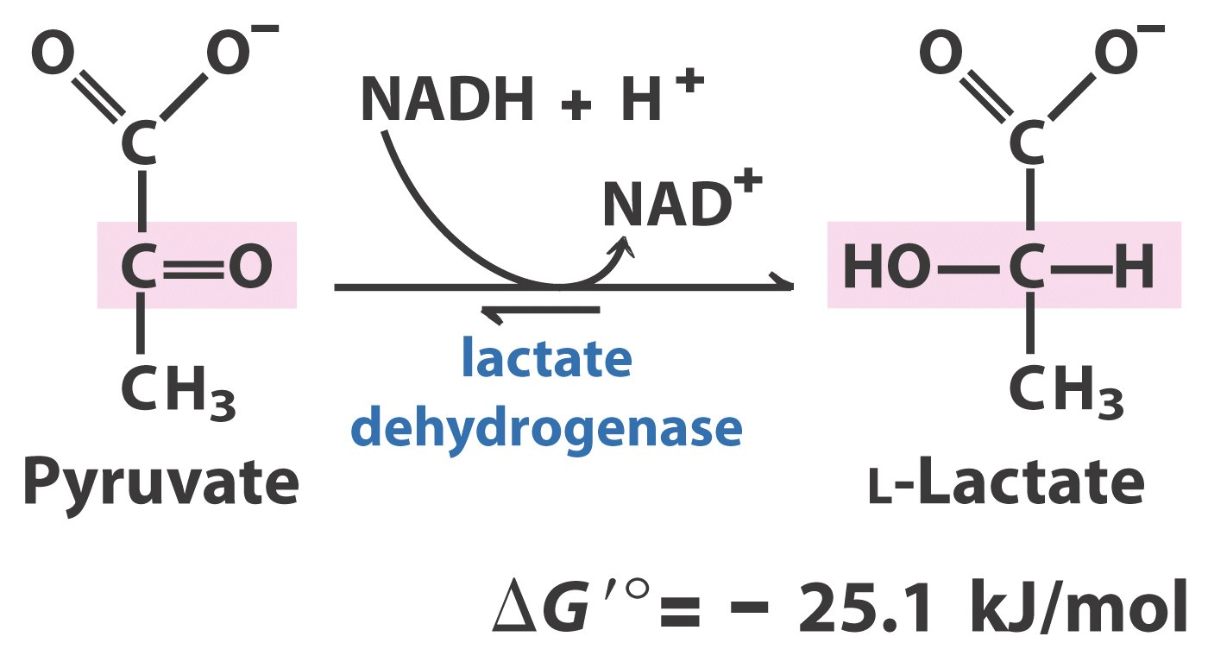
Pyruvate is reduced to lactate when O₂ lacks
in a reaction catalyzed by lactate dehydrogenase
Named for the
reverse reaction

Slide 40
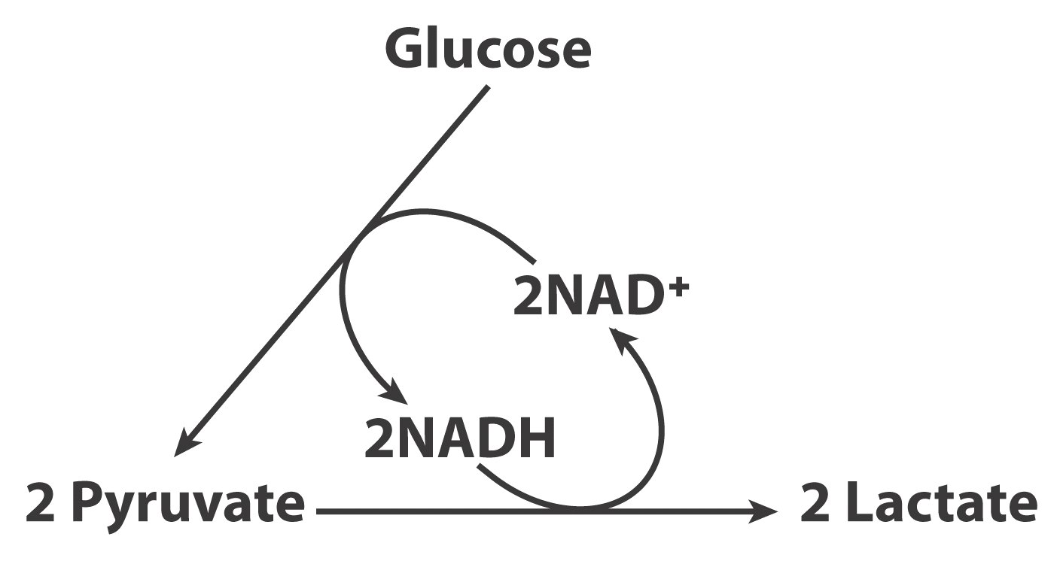
Fermentation is the process which extracts
energy (as ATP) but does not consume oxygen
or change the concentration of NAD⁺ or NADH.

Slide 41
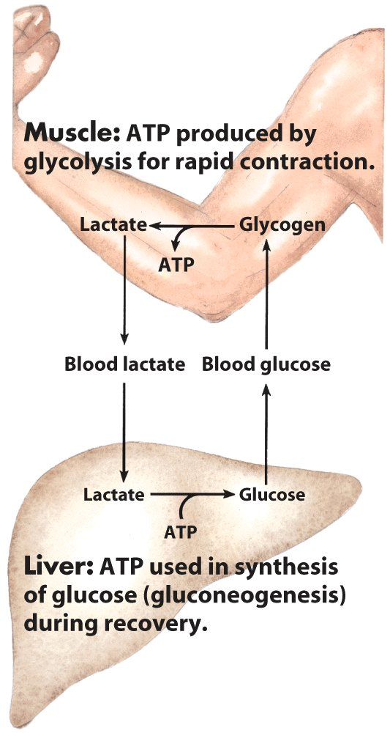
Metabolic cooperation
between skeletal muscle
and the liver
The Cori cycle

Slide 42
Ethanol fermentation (occurring in yeast and other microorganisms): pyruvate is first decarboxylated and then reduced by NADH, catalyzed by pyruvate decarboxylase and alcohol dehydrogenase respectively.
Thiamine pyrophosphate (TPP, 硫胺焦磷酸, derived from vitamin B₁) act as the coenzyme of the decarboxylase.

Slide 43
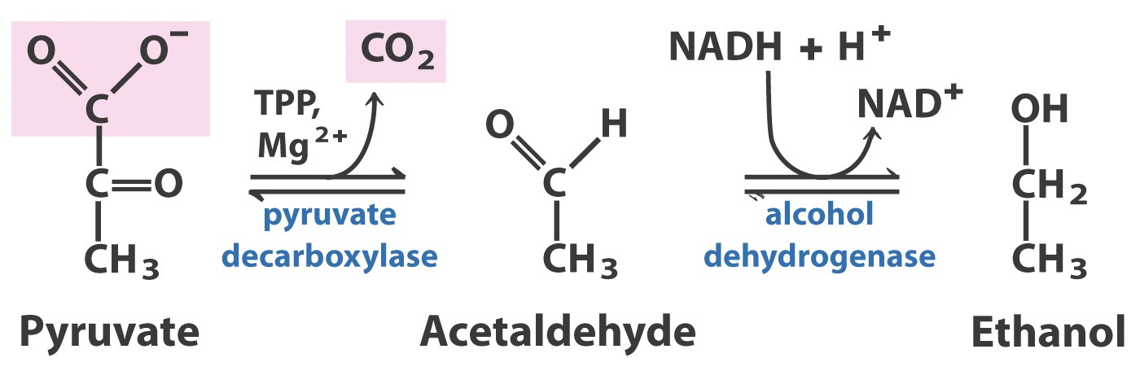
Present only in
those alcohol
fermentative organisms
Present in many
organisms, including
human
Pyruvate can be reduced to ethanol
in some microorganisms

Slide 44
4. Other hexoses are also oxidized via the glycolysis pathway
They are also first primed by phosphorylation (at C-1 or C-6).
Fructose is primed and cleaved to form dihydroxyacetone phosphate and glyceraldehyde, which are further converted to glyceraldehyde 3-phosphate.
Galactose is first converted to glucose-1-phosphate via a UDP-galactose intermediate and UDP-glucose intermediate, then to glucose-6-phosphate.

Slide 45
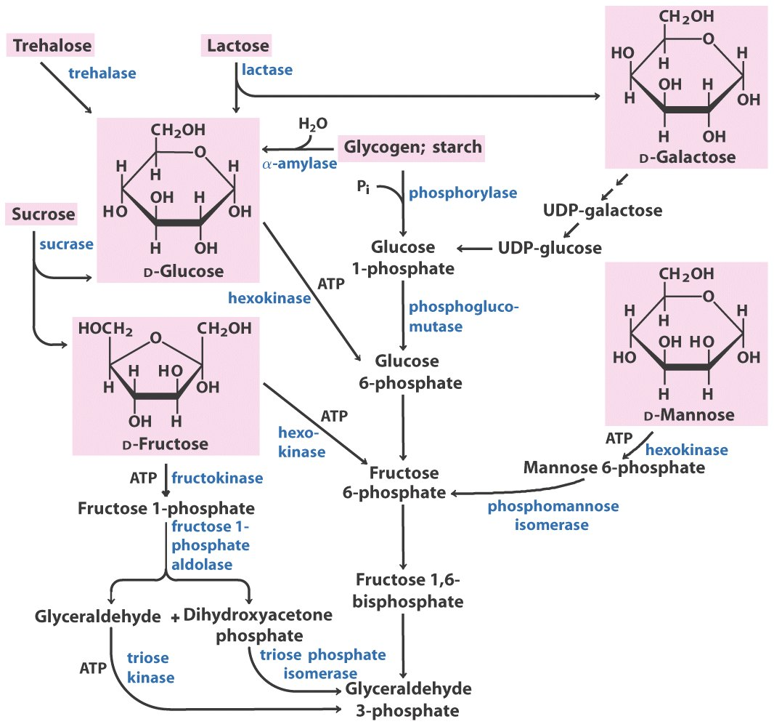
in liver
in muscle and kidney

Slide 46
5. Dietary poly- and disaccharides are hydrolyzed to monosaccharides in the digestive system
Salivary α-amylase (α-淀粉酶) in the mouth hydrolyzes starch (glycogen) into short polysaccharides or oligosaccharides.
Pancreatic α-amylase continue to convert the saccharides to mainly maltose and dextrin (from amylopectin, 枝链淀粉).
Specific enzymes on the microvilli of the intestinal epithelial cells finally hydrolyze all disaccharides into monosaccharides.

Slide 47
The monosaccharides are then absorbed at the intestinal microvilli and transported to various tissues for oxidative degradation via the glycolytic pathway.
Adults lacking lactase will have lactose intolerance syndrome (乳糖不耐受综合征): the lactose is converted to toxic compounds in the large intestine by the bacteria there, causing abdominal cramps and diarrhea.
Lactose + H₂O D-galactose + D-glucose
lactase

Slide 48
6. Glycogen and starch are degraded by phosphorolysis
The glucose unit at the nonreducing terminal of glycogen is removed as glucose 1-phosphate via phosphorolysis catalyzed by glycogen phosphorylase.
Glucose 1-phosphate is then converted to glucose 6-phosphate by phosphoglucomutase.

Slide 49
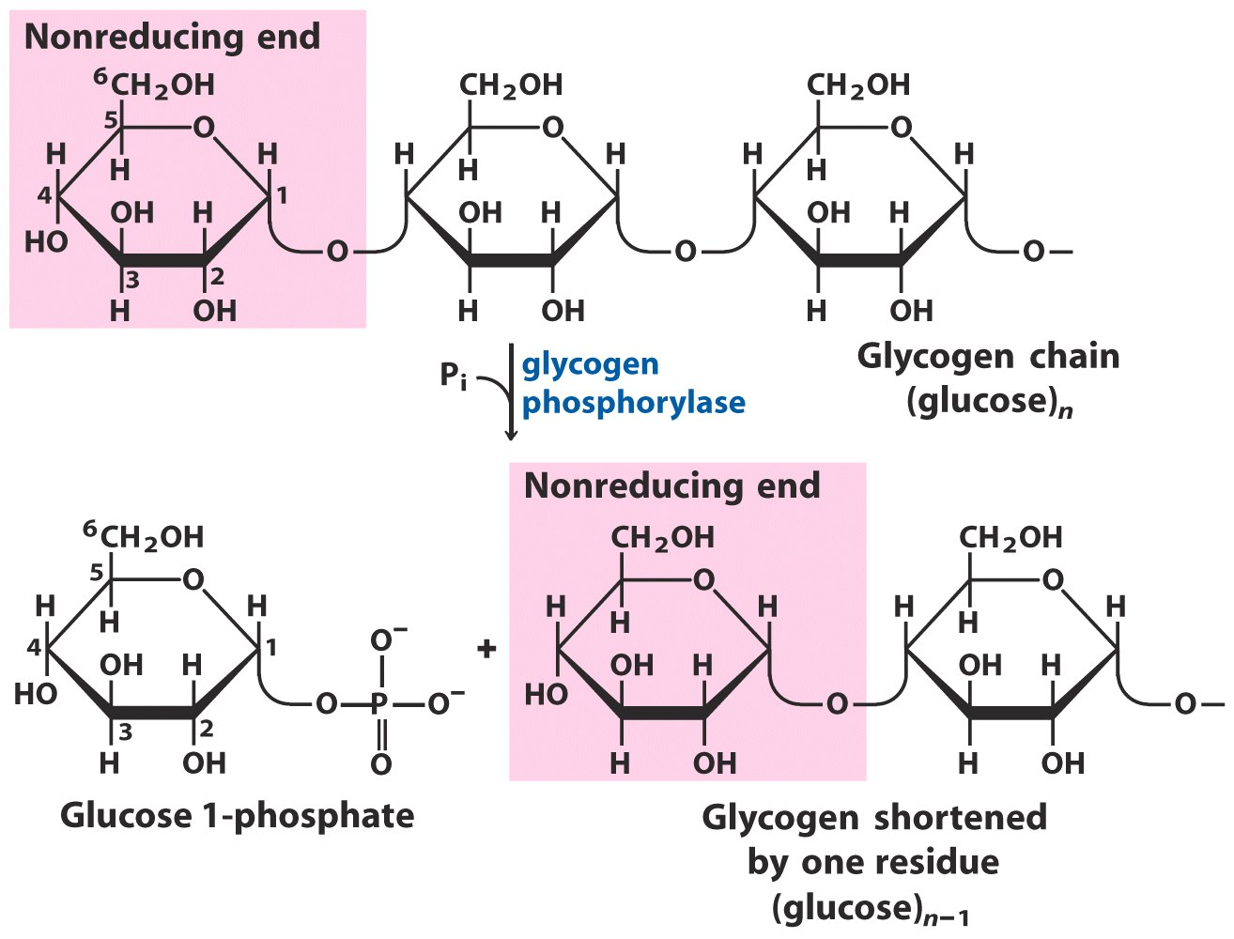
No ATP needed!
Glycogen breakdown by glycogen phosphorylase

Slide 50
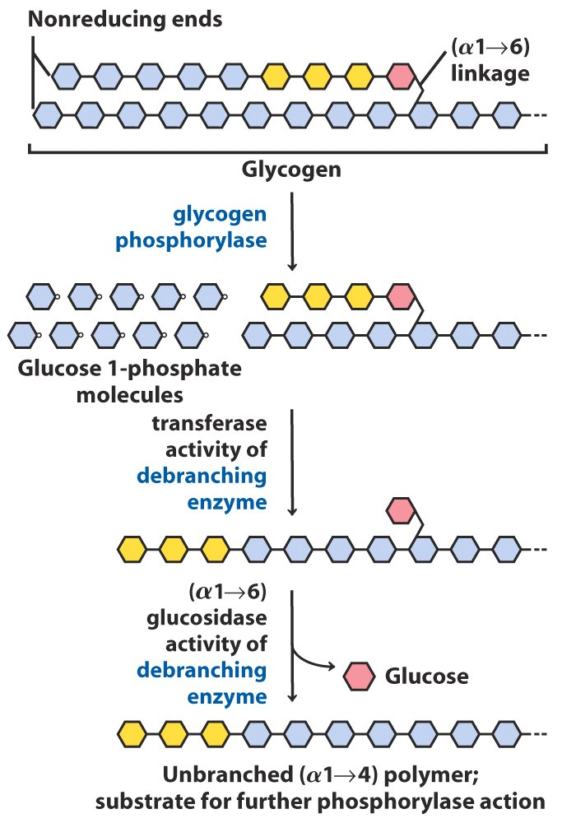
A bifunctional
debranching enzyme aids
the phosphorylase in
degrading glycogen
(Figure 15-26)

Slide 51
7. Pentose phosphate pathway converts glucose to specialized products needed by the cells
Glucose 6-phosphate + 2NADP⁺ + H₂O
ribose 5-phosphate +2NADPH + CO₂ + 2H⁺

Slide 52
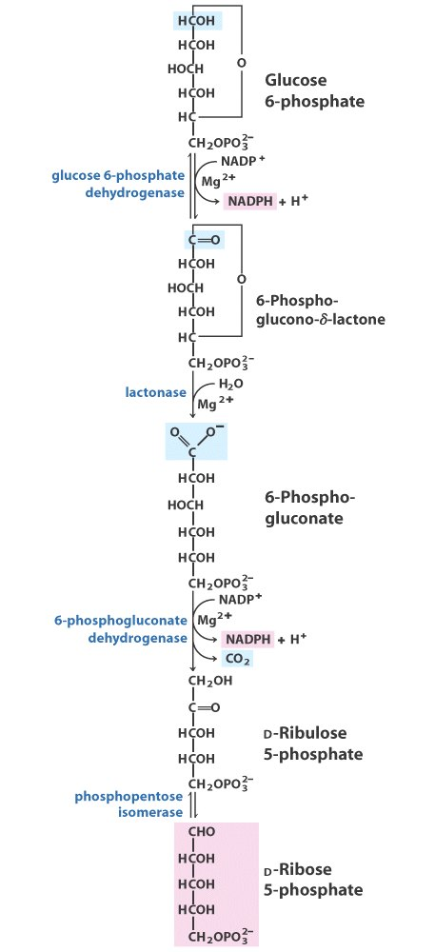
Oxidative reactions
of the pentose
phosphate pathway

Slide 53
Prominent in tissues actively synthesizing fatty acids and steroids, such as mammary gland, adrenal cortex, liver and adipose tissues.
Pentose generated is necessary for biosynthesis of nucleic acids.
If not needed, six five-carbon sugar phosphates are converted to five six-carbon sugar phosphates.
The reverse of this rearrangement, regeneration of six five-carbon sugar phosphate from five six-carbon sugar phosphate occurs in the Calvin cycle for photosynthetic fixation of CO₂ in plants (To be discussed in Chapter 20).

Slide 54
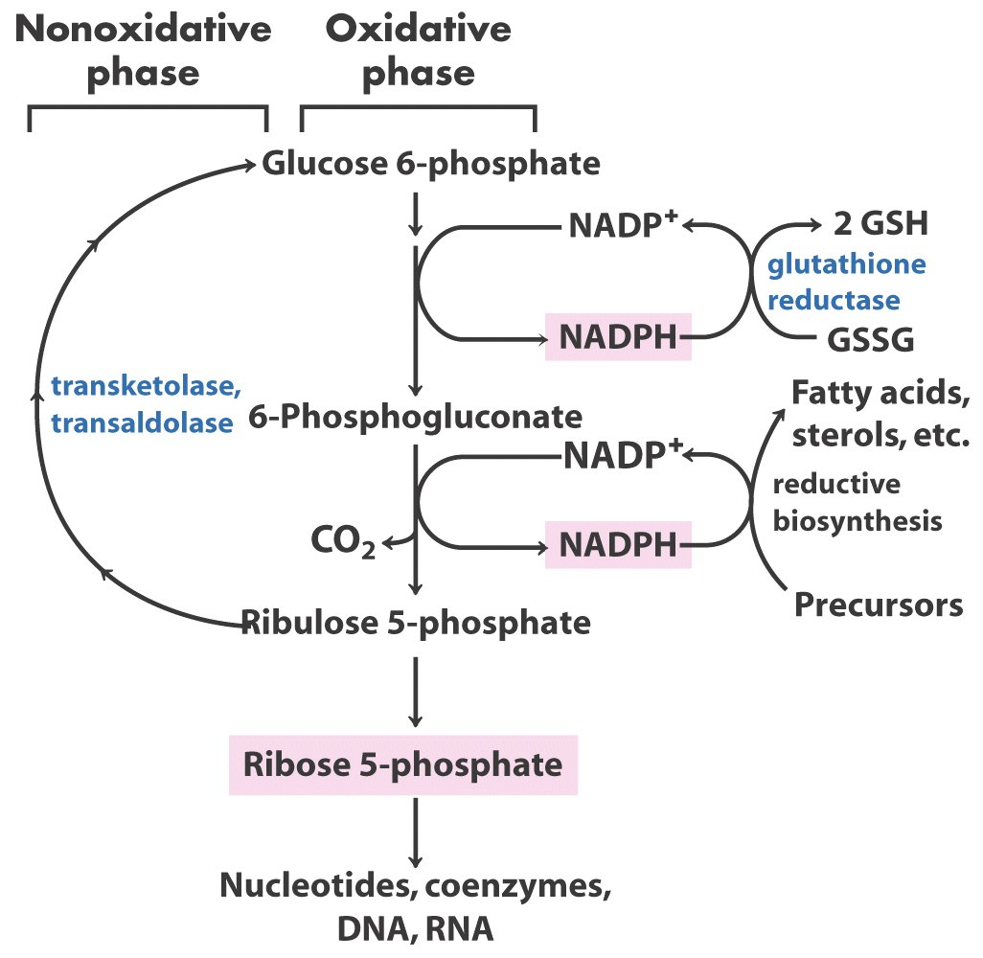
General scheme of the pentose phosphate pathway

Slide 55
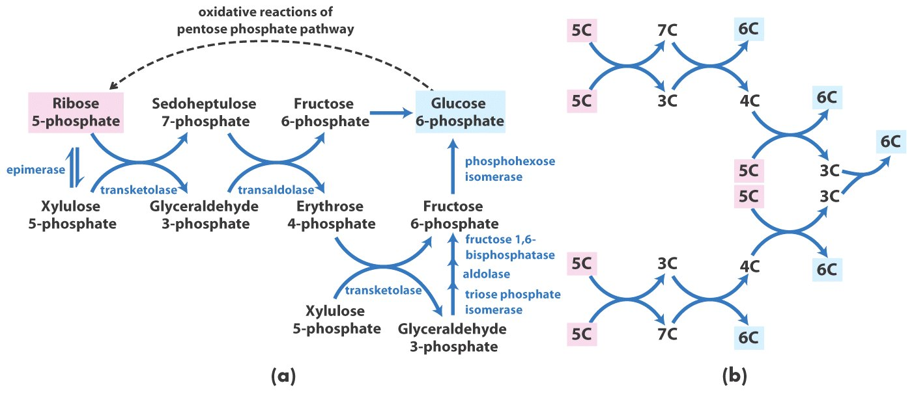
The regeneration of six-carbon glucose-6-phosphate from five-carbon ribose-5-phosphate in the pentose phosphate pathway (nonoxidative)

Slide 56
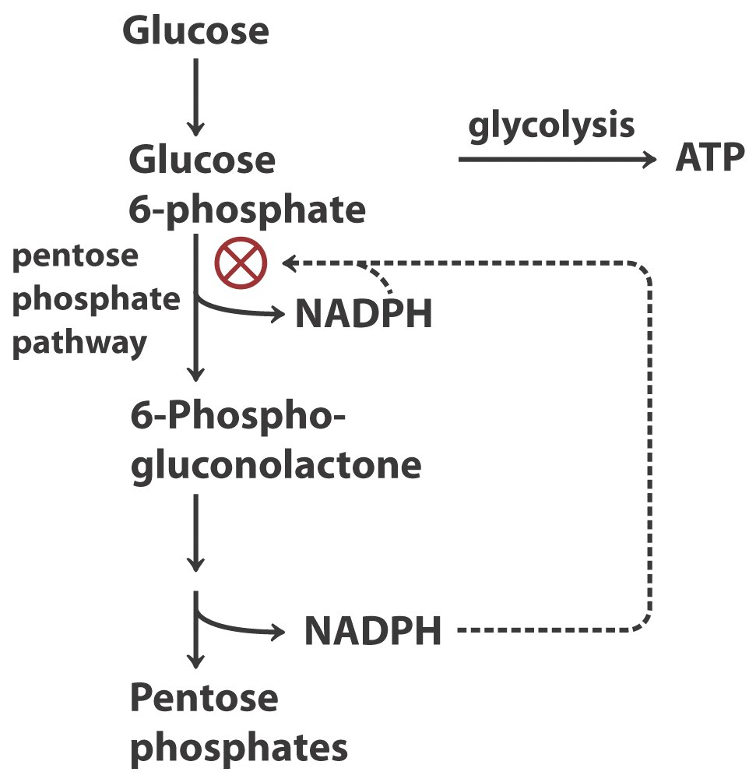
Role of NADPH in regulation

Slide 57
8. Regulation of glycolysis
Regulatory enzymes of glycolysis:
Hexokinase
Phosphofructokinase-1 (PFK-1)
Pyruvate kinase
They all catalyze exergonic and
irreversible reactions, and are
all regulated by allosteric effectors.

Slide 58
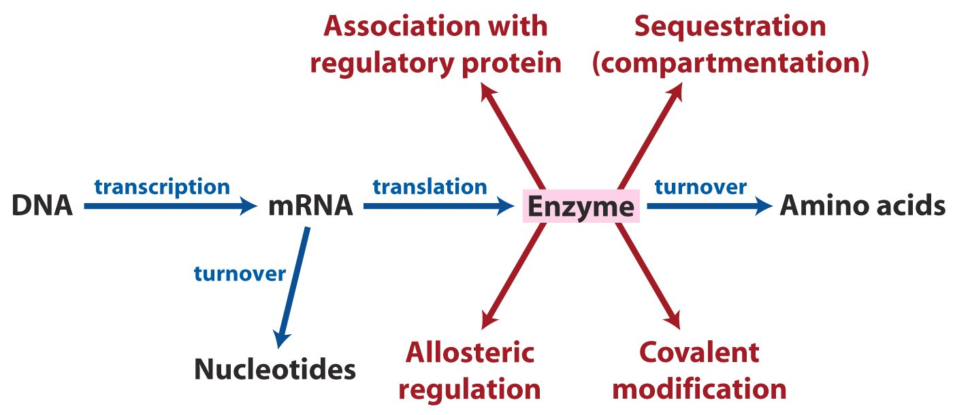
Factors that determine the activity of an enzyme

Slide 59
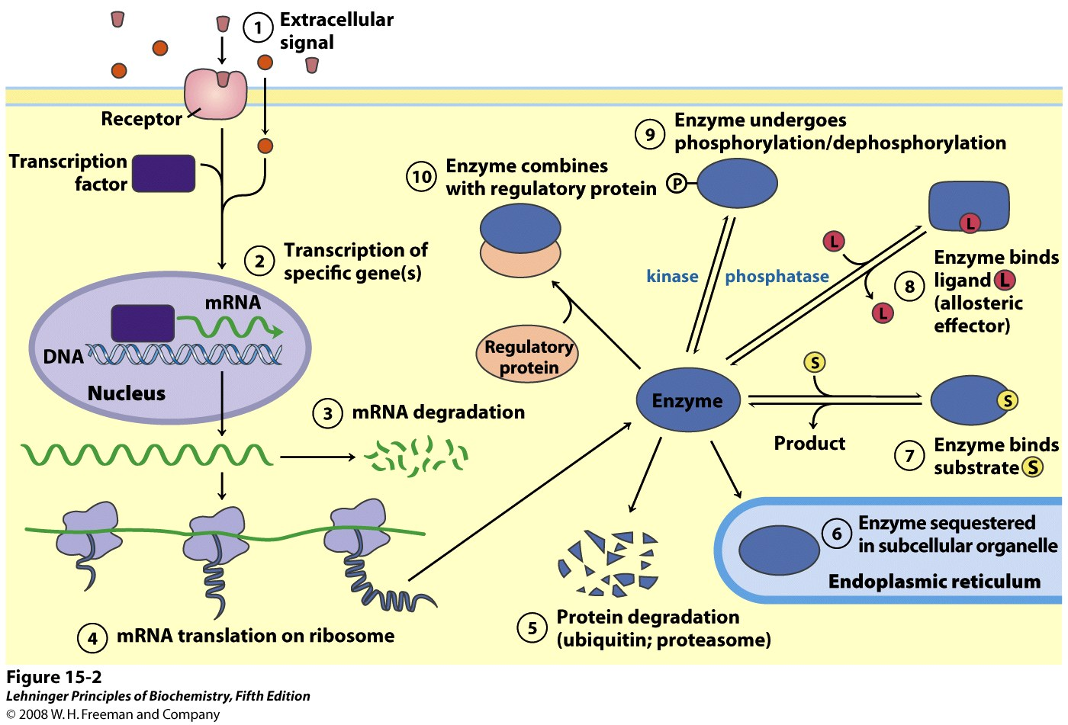
Factors that determine the activity of an enzyme

Slide 60
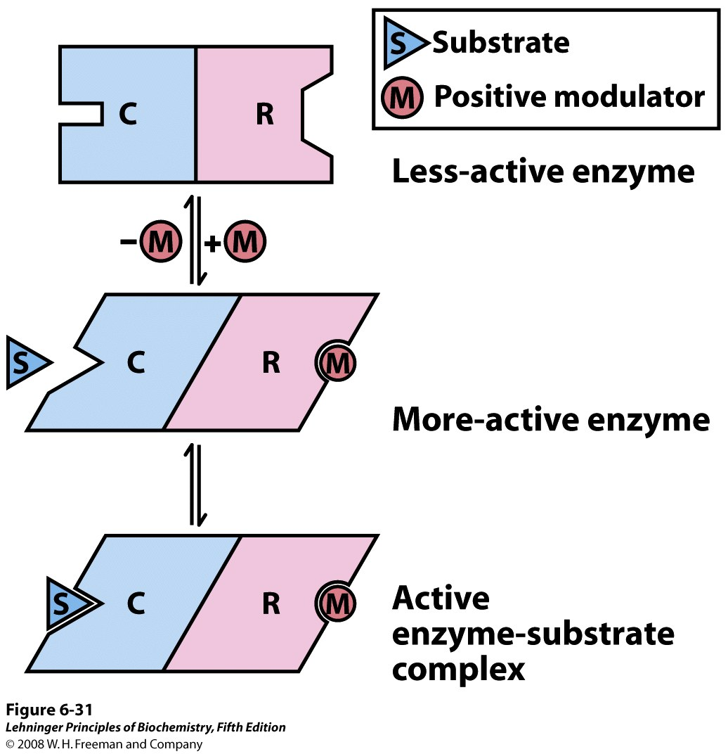
Subunit interactions in an allosteric enzyme, and interactions with inhibitors and activators
In many allosteric enzymes the substrate binding site and the modulator binding site(s) are on different subunits,
the catalytic (C) and regulatory (R) subunits, respectively. Binding of the positive (stimulatory) modulator (M) to
its specific site on the regulatory subunit is communicated to the catalytic subunit through a conformational change.
This change renders the catalytic subunit active and capable of binding the substrate (S) with higher affinity.
On dissociation of the modulator from the regulatory subunit, the enzyme reverts to its inactive or less active form.
Notes:
FIGURE 6-31 Subunit interactions in an allosteric enzyme, and interactions with inhibitors and activators. In many allosteric enzymes the substrate binding site and the modulator binding site(s) are on different subunits, the catalytic (C) and regulatory (R) subunits, respectively. Binding of the positive (stimulatory) modulator (M) to its specific site on the regulatory subunit is communicated to the catalytic subunit through a conformational change. This change renders the catalytic subunit active and capable of binding the substrate (S) with higher affinity. On dissociation of the modulator from the regulatory subunit, the enzyme reverts to its inactive or less active form.

Slide 61
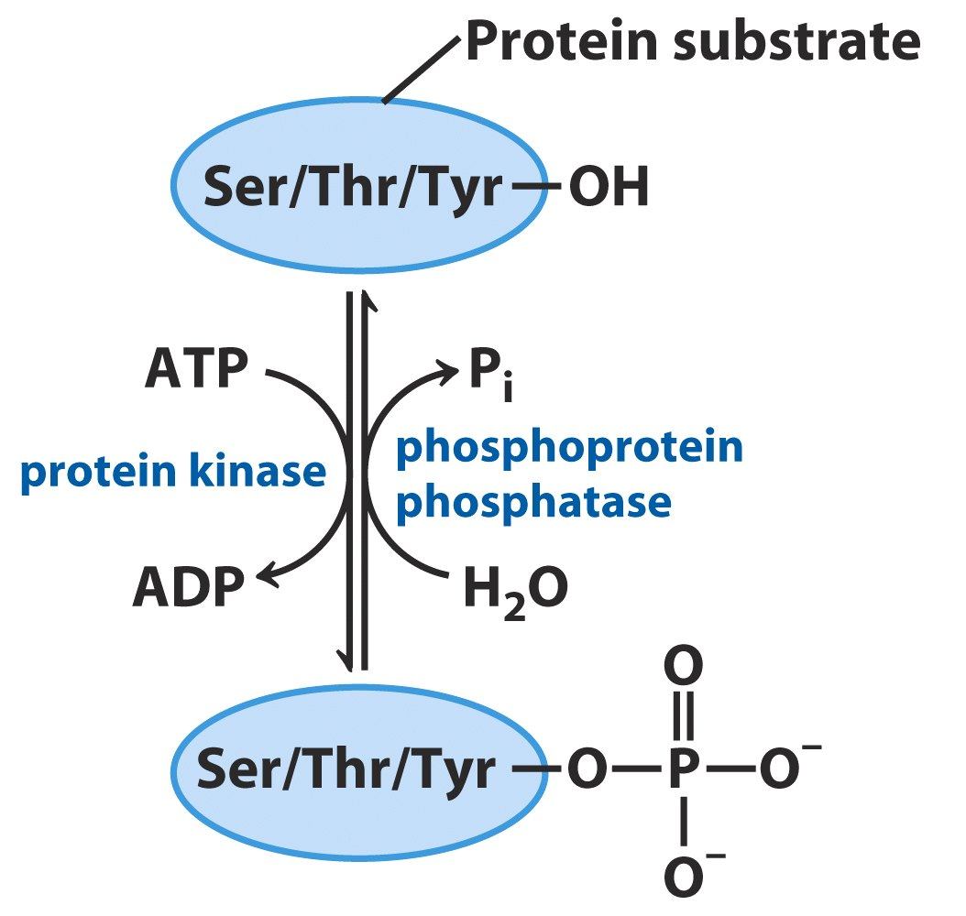
Protein phosphorylation and dephosphorylation

Slide 62
The rate of glycolysis in mammals is mainly controlled at the step acted by phosphofructokinase-1 (PFK-1)
PFK-1 catalyzes an irreversible and exergonic reaction, which commits glucose to the glycolysis pathway (away from the pentose phosphate pathway).
PFK-1 is a complex tetrameric enzyme regulated by multiple intracellular signals (allosteric effectors): ATP, citrate being negative ones; AMP, ADP and fructose 2,6-bisphosphate as positive ones.

Slide 63
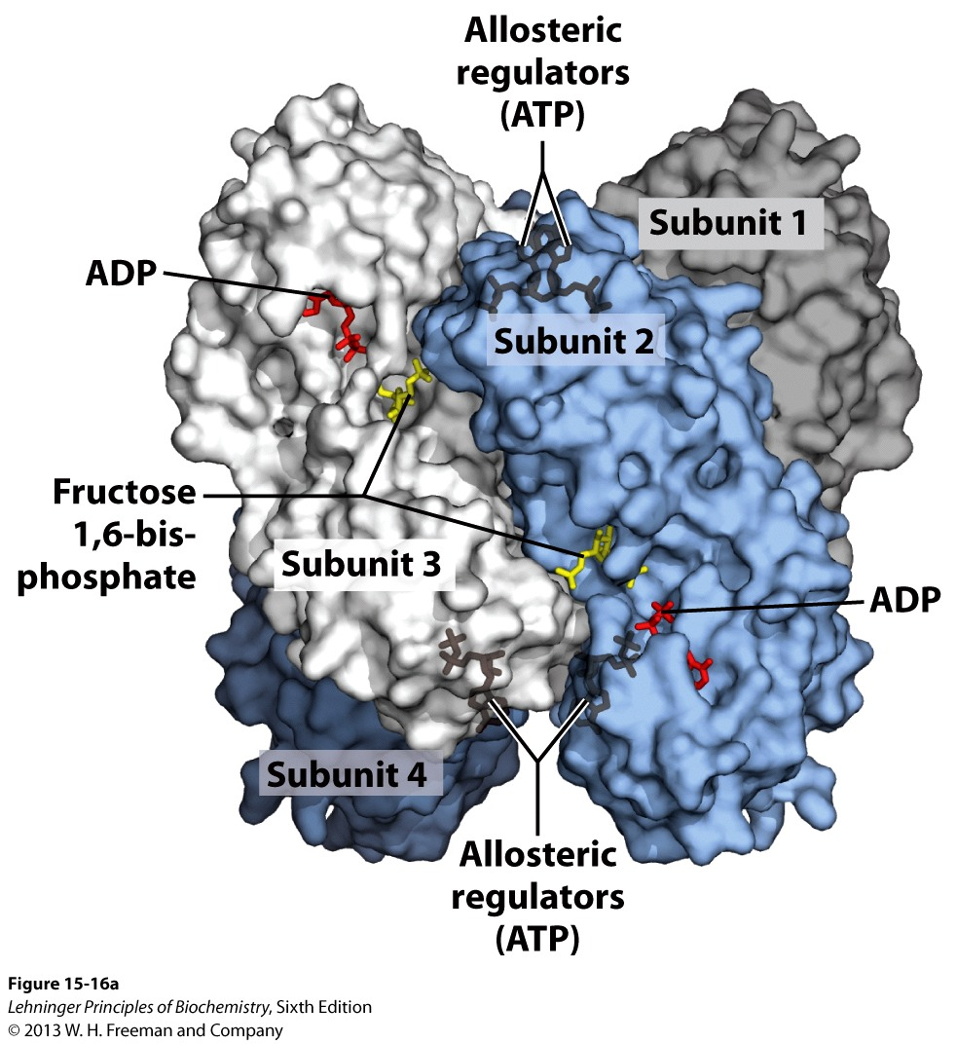
E. coli PFK-1 has
four identical subunits.
Each subunit has its
own catalytic site and
regulatory site.

Slide 64
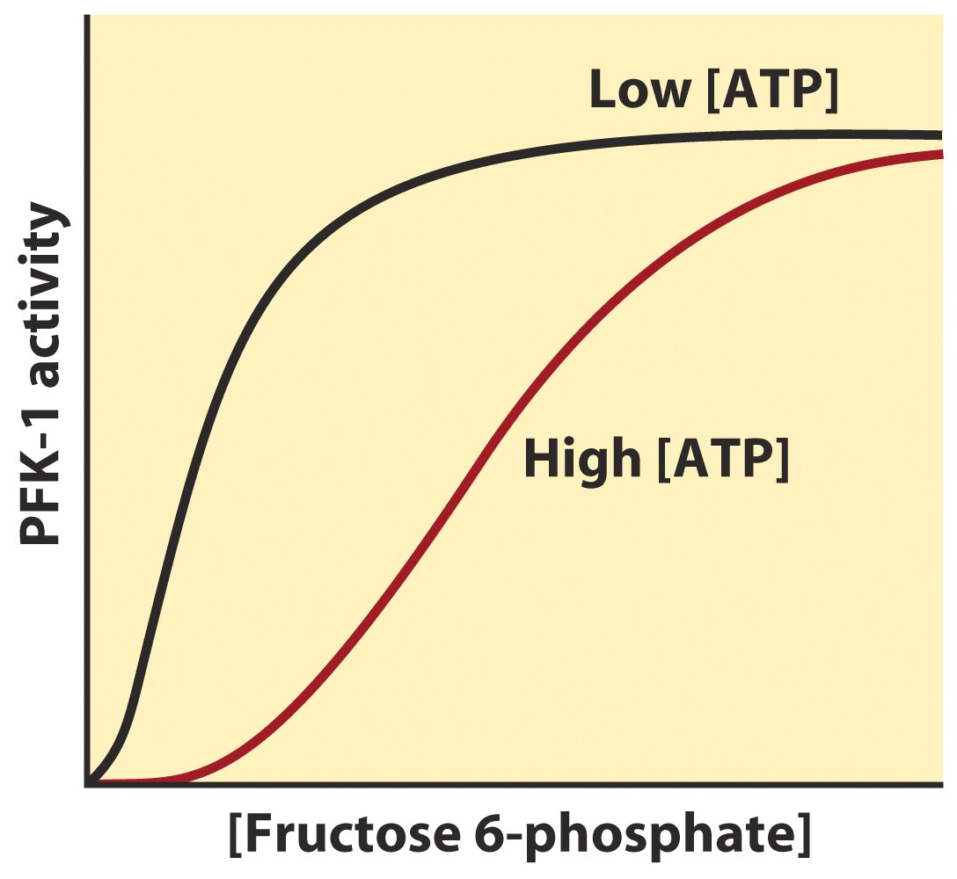
Allosteric regulation of muscle PFK-1 by ATP

Slide 65
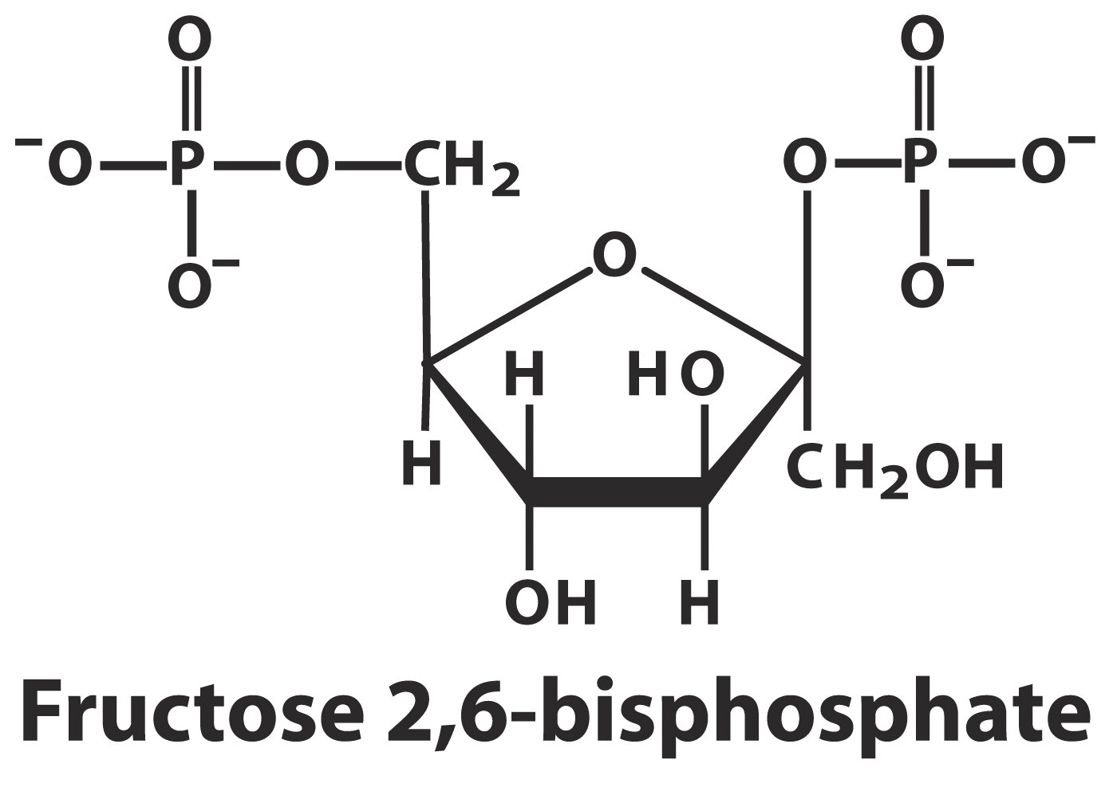

Slide 66
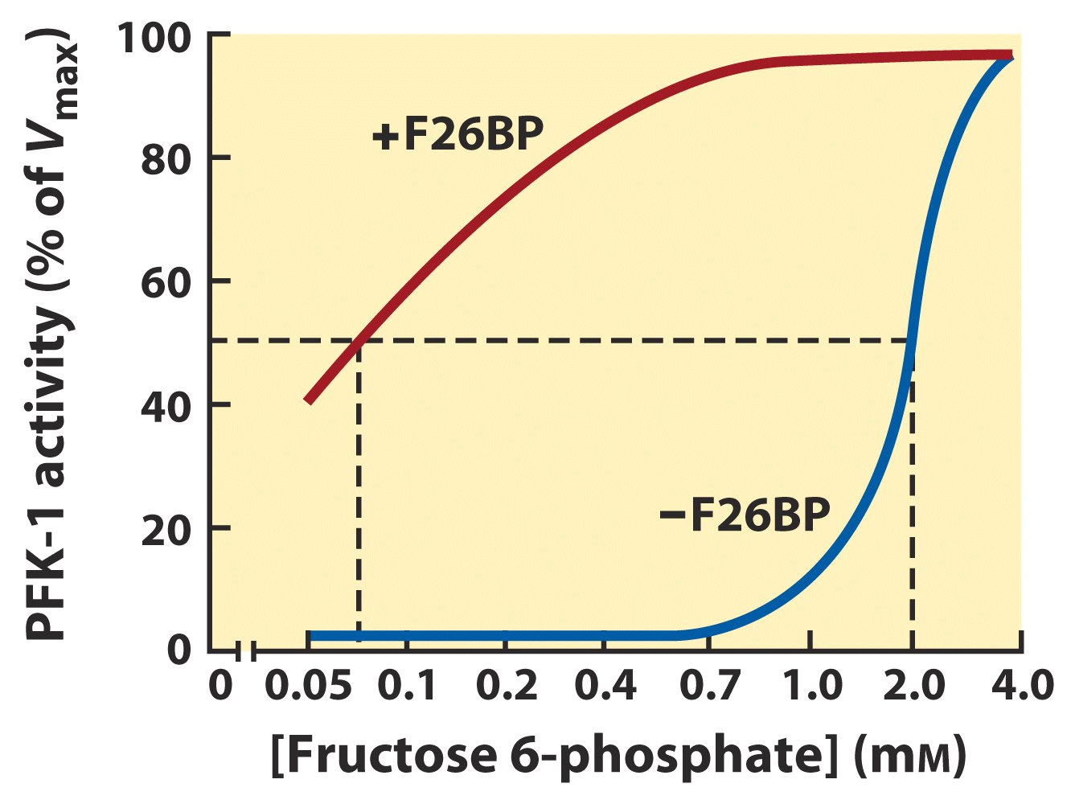
(0.13μM)
F-2,6-BP activates PFK-1

Slide 67
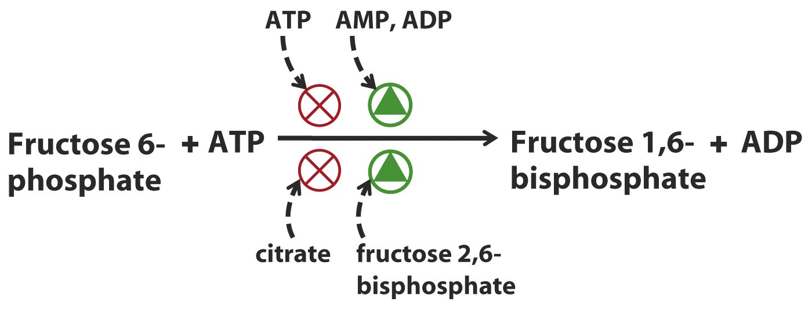
Regulators that affect PFK-1 activity

Slide 68
Hexokinase and pyruvate kinase also set the pace of glycolysis
These two enzymes also catalyze irreversible and exergonic reactions.
Pyruvate kinase is allosterically inhibited by ATP, acetyl-CoA, and long-chain fatty acids.
The catalytic activity of the liver pyruvate kinase isozyme (the L type) is also controlled by reversible phosphorylation.
Hexokinase isozymes are regulated differently.

Slide 69
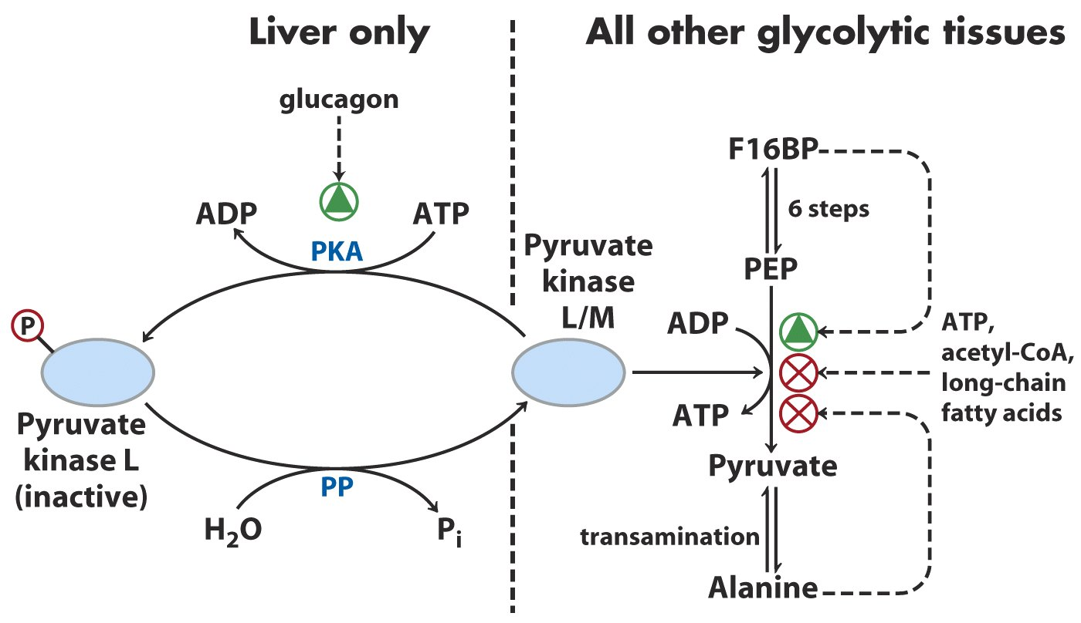
Regulation of pyruvate kinase

Slide 70
Different roles of muscle and liver in glucose metabolism
Muscle consumes glucose, using it for energy production.
Liver produces and distributes glucose for other tissues, maintaining a constant blood glucose level.

Slide 71
Liver and muscle hexokinase isozymes are regulated differently
Muscle hexokinase is allosterically inhibited by its reaction product glucose 6-phosphate, which accumulates when PFK-1 is inhibited.
Liver hexokinase (also called hexokinase IV or glucokinase) has about 100 X less affinity for glucose than that in muscle, therefore, is regulated by the level of blood glucose.
Liver hexokinase is not inhibited by glucose 6-phosphate: its main role is to convert excess glucose to glucose-6-phosphate for glycogen synthesis.

Slide 72
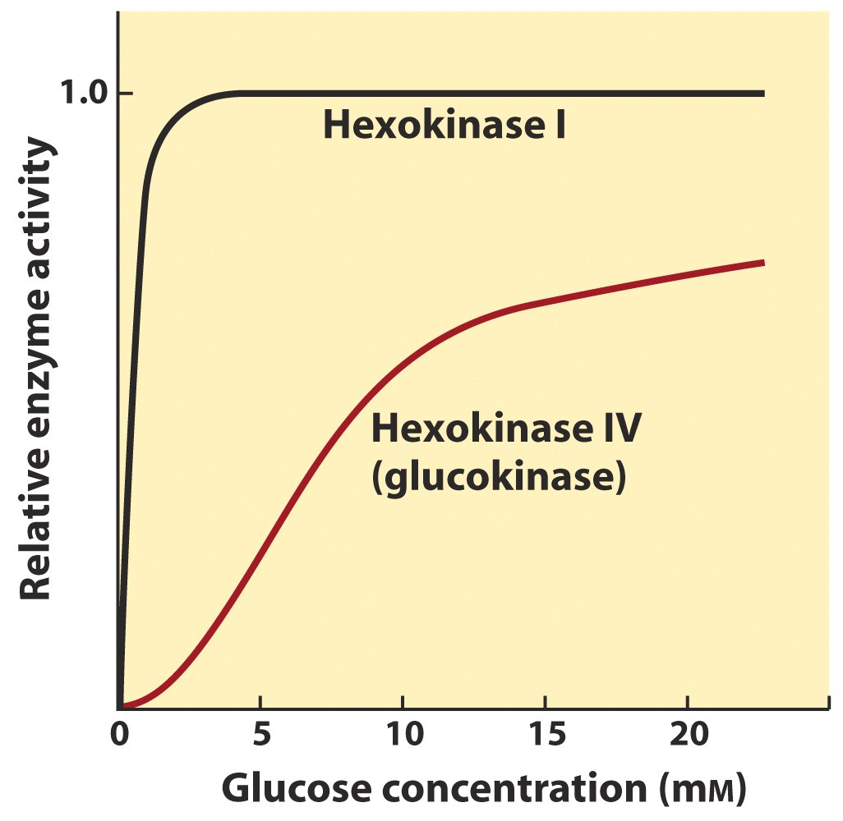
(Muscle)
(Liver)
Comparison of kinetic properties of
liver Hexokinase IV and muscle Hexokinase I

Slide 73
9. Regulation of glycogen phosphorylase
There are two isozymes for glycogen phosphorylase: one in liver and one in muscle
Both are in two interconvertible forms: the a form is phosphorylated and more active; the b form is dephosphorylated and less active.
Both phosphorylation and dephosphorylation occur and catalyzed by specific phosphorylase b kinase and phosphorylase a phosphatase respectively.

Slide 74
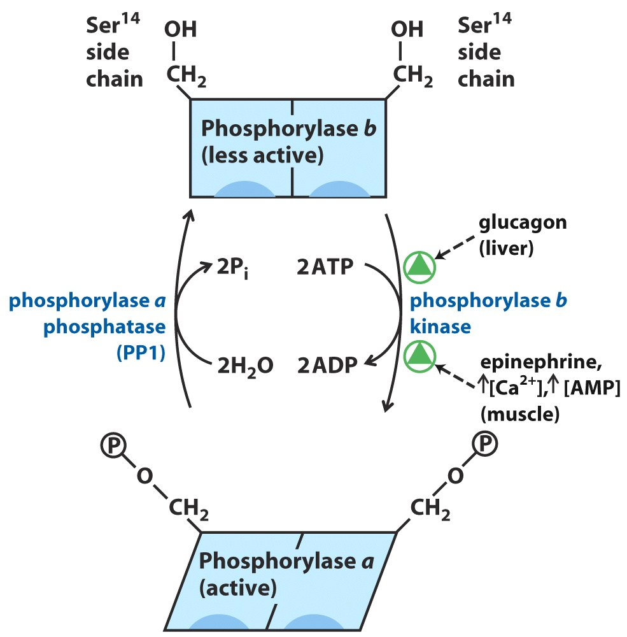
Covalent modification of glycogen phosphorylase

Slide 75
Glycogen phosphorylase kinase is regulated by different hormones in muscle and in liver
In muscle, by epinephrine (肾上腺素)
---secreted by the medulla of the adrenal gland
(肾上腺髓质)
In liver, by glucagon (胰高血糖素)
---secreted by the pancreas

Slide 76
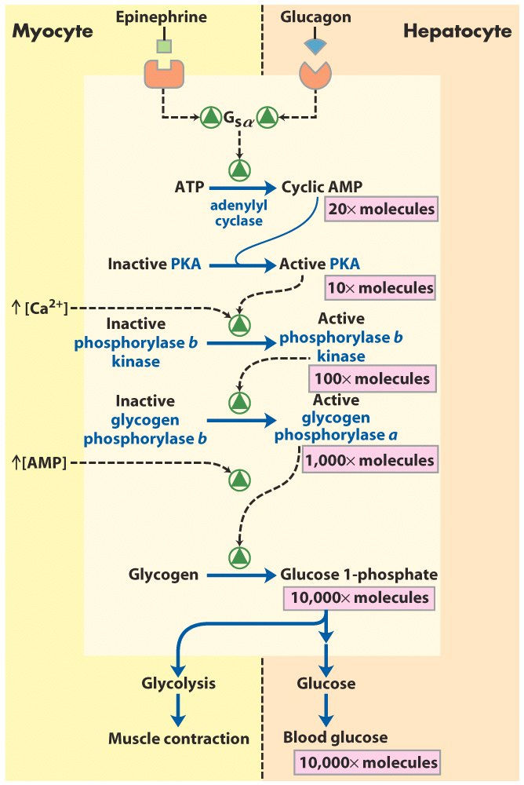
Cascade mechanism of
epinephrine and
glucagon action

Slide 77
Glycogen phosphorylase is also regulated allosterically, but differently in muscle and liver
In muscle:
Ca²⁺ binds and activates phosphorylase b kinase.
AMP binds and activates phosphorylase b.
ATP inactivates phosphorylase.
In liver:
Glucose binds to the a form of enzyme, exposing the phosphorylated Ser residues to the action of phosphorylase a phosphatase and converting it to the less active b form.

Slide 78

The liver glycogen phosphorylase a is
negatively regulated by glucose, therefore,
can function as a glucose sensor

Slide 79
10. Glycolysis and gluconeogenesis are coordinately regulated to avoid the wasteful “futile cycling”
Gluconeogenesis: The pathway converting simple precursors (e.g., pyruvate and lactate) to glucose, mainly occurring in the liver of mammals.
Gluconeogenesis uses most of the same enzymes of glycolysis, but the three exergonic irreversible reactions (catalyzed by the three regulatory enzymes) are detoured (bypassed).

Slide 80

Bypass reaction

Slide 81
The unique enzymes catalyzing the two reversing reactions at one detouring step are reciprocally regulated by common allosteric effectors: fructose 2,6-bisphosphate activates PFK-1 (thus activate glycolysis) and at the same time inhibits fructose 1,6-bisphosphatase 1 or FBPase-1 (thus inhibit gluconeogenesis).
Enzymes catalyzing the non-common steps of paired catabolic and anabolic pathways are often reciprocally regulated to avoid futile cycling.

Slide 82
Keywords
Glycolysis----3 irreversible reactions
Pentose phosphate pathway----products
PFK-1----commitment step, regulation
Glycogen phosphorylase----regulation

Slide 83
Words of the week
aerobic (有氧的) vs. anaerobic (厌氧的)
selfish vs. generous
mono
di
tri
tetra
penta
hexa
hepta
octa

Slide 84
Text-book reading of the week
Summary 14.1 (p558)
Summary 14.2 (p563)
Summary 14.3 (p568)
Summary 14.5 (p580)
p602-606 (regulation of hexokinase and PFK-1)
p621-622 (regulation of glycogen phosphorylase)

Slide 85
Summary
Glucose is a commonly used fuel and versatile precursor in almost all organisms.
The study of glucose degradation has a rich history in biochemistry (especially for enzymology).
Glucose is first converted into two three-carbon pyruvate via the ten-step glycolysis pathway without directly consuming O₂ and with a net production of two ATP molecules by substrate-level phosphorylation.
Limited amount of energy can be released by oxidizing glucose under anaerobic conditions by fermentation.
The sugar units on glycogen is converted to glucose 1-phosphate via phosphorolysis, which is catalyzed by glycogen phosphorylase.

Slide 86
Other monosaccharides are also converted to intermediates of glycolysis for further oxidative degradation.
Glucose 6-phosphate can also be oxidized to form ribose 5-phosphate and NADPH via the pentose phosphate pathway.
Phosphofructokinase-1 (PFK-1) is the main point of regulation for controlling the rate of glycolysis.
The activity of PFK-1 is regulated by various effectors having various signaling messages of the cell metabolism.
Glycogen phosphorylase is regulated by allosteric effectors and reversible phosphorylation, which is in turn controlled by hormones.
The liver and muscle glycogen phosphorylases are regulated differently to meet their physiological roles.
Glycolysis and gluconeogenesis are reciprocally regulated to avoid “futile cycling” of synthesis and degradation.

